Slide 1
Update on Post CZU Fire Response Action Planning
November 10, 2020

Slide 2
Presentation Overview
Our goal
The challenges
Actions we are taking to ensure we can continuously achieve our goal

Slide 3
Our goal

Slide 4

Now More Than Ever
A safe, reliable supply of drinking water 24/7/365

Slide 5
The challenges

Slide 6
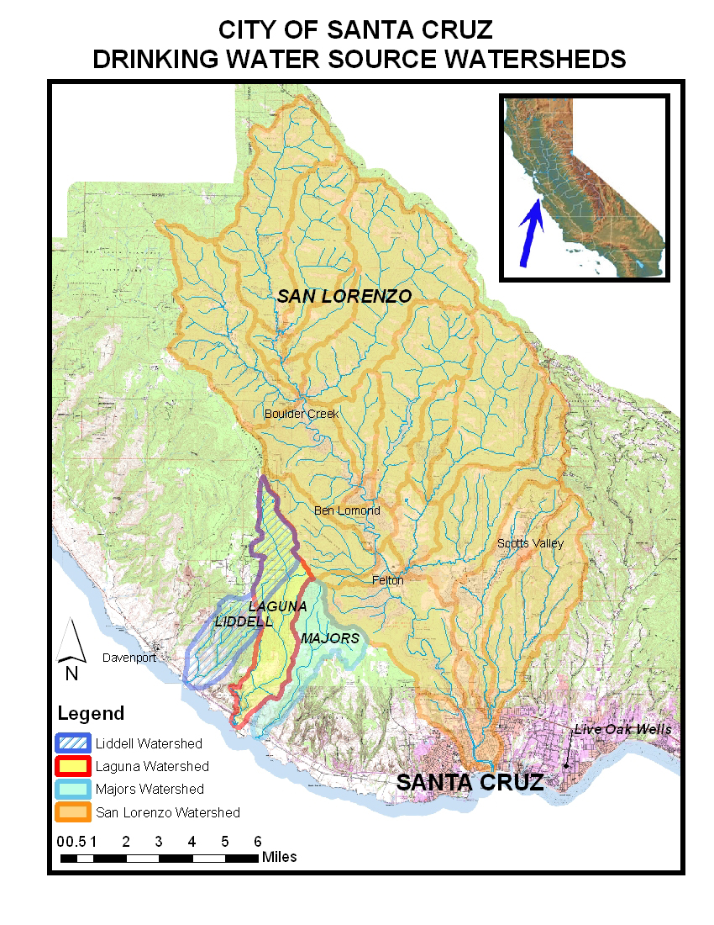

Slide 7
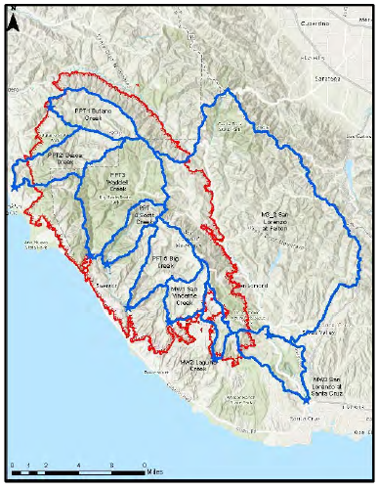
Watersheds in the CZU Lightning Fire
  Blue lines are watershed hydro-graphic boundaries
  Red lines is the CZU fire perimeter

Slide 8
A Key Concern Is Polluted Run-Off From Fire Damaged Areas
The San Lorenzo River is the source of the majority of the City’s water supply;
Although the San Lorenzo watershed was less impacted than other parts of the burn area, the potential for polluted run-off from burned areas is real and not insignificant.

Slide 9
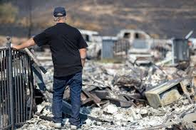
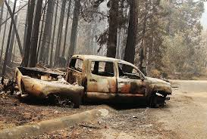
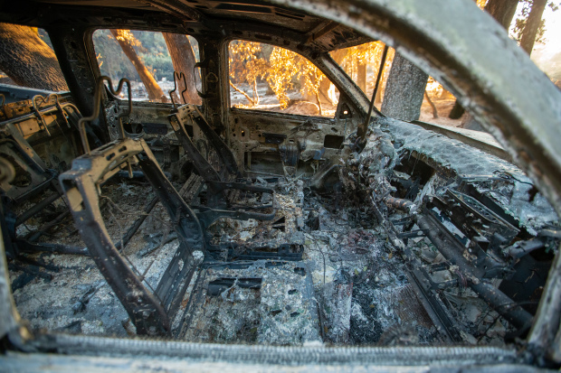
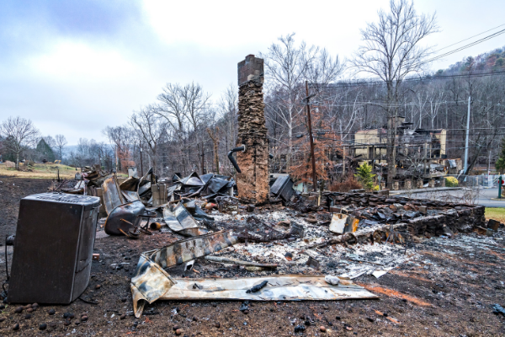

Slide 10
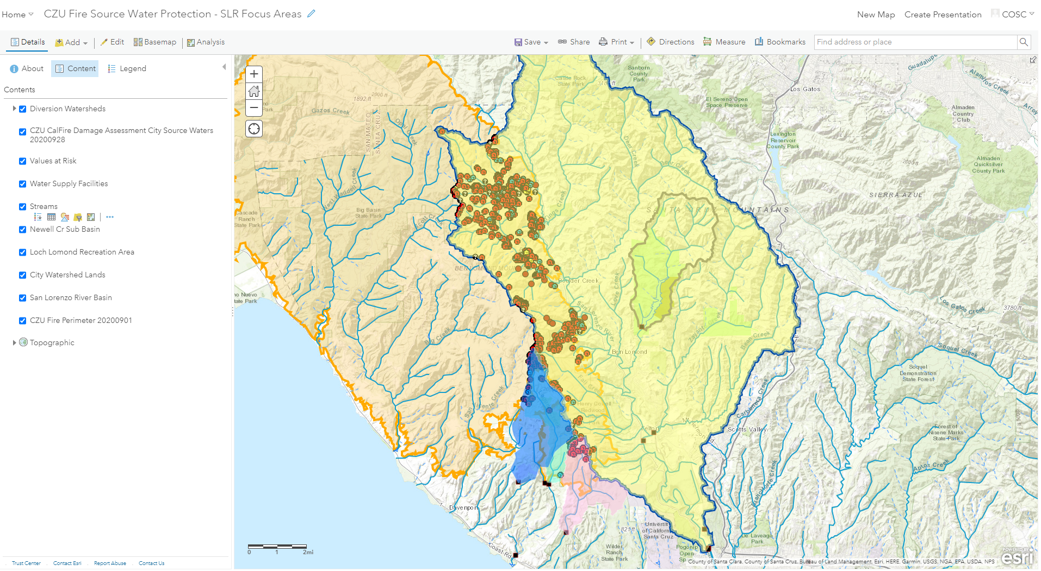
Brown and Blue Circles are priority properties for debris removal activities scheduled to begin in December

Slide 11
Additional Information on Phase 2 Debris Removal
http://scceh.com/Portals/6/Env_Health/CZU_Fire/DebrisRemovaleng.pdf
https://www.co.santa-cruz.ca.us/FireRecovery/DebrisRemoval/PhaseIIDebrisRemoval.aspx

Slide 12
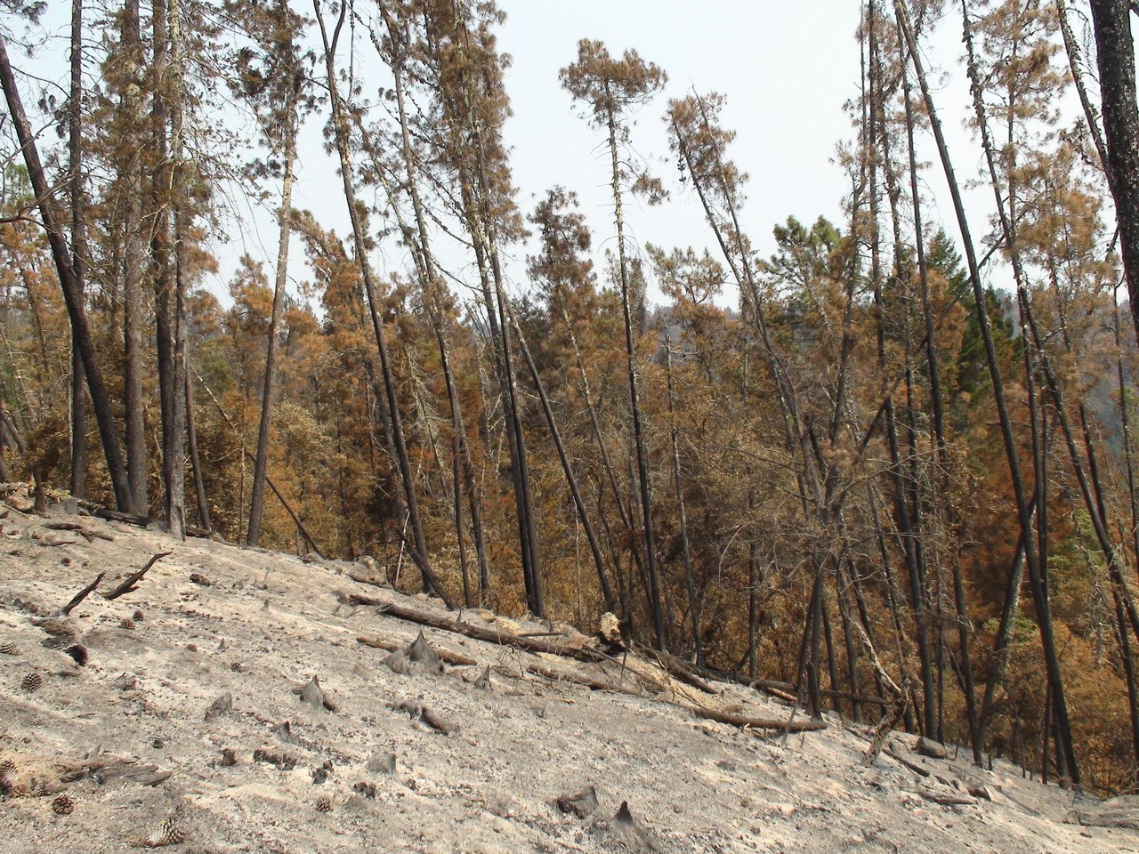
Burned Area Above Laguna and Majors Creeks Near the Laguna Diversion

Slide 13
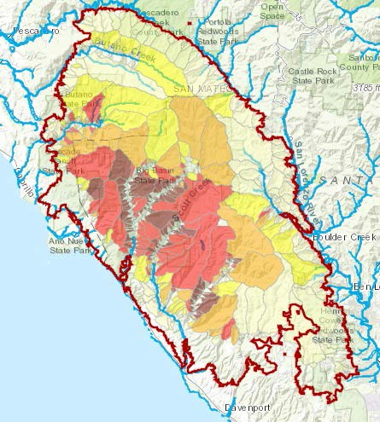
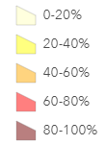
Debris Flow Basin Probability
≈ 0.25 inches in 15 minutes

Slide 14
Fire response action planning –
Focusing on three key elements to ensuring safe and reliable supply

Slide 15
RELIABLE WATER SUPPLY
WATER QUALITY DATA
TREATMENT PROCESSES
INFRA-STRUCTURE RELIABILITY
.

Slide 16
Water Quality Data Drives Treatment Process Management
Key treatment process parameters can change as a result of run-off or debris flows from burned areas;
Depending on the degree of change, treatment processes can be adjusted or a potentially impaired source can be taken out of service and alternate sources or supplies brought on line.

Slide 17
Water Quality Data Collection
Added water quality sampling locations to make sure we have relevant data from fire impacted areas;
Added water quality parameters to sample for, including benzene, dioxin, furans, and tetrachlorodibenzodioxin;
Increased sampling frequency, including event sampling, to ensure that water quality changes aren’t missed.

Slide 18
Treatment Processes
Water with higher sediment, nutrient, or organic carbon loading is more challenging to treat;
The Graham Hill Water Treatment Plant’s treatment process is adaptable to changing water quality only up to a certain point. Beyond that point, the only choice is to let more impaired water bypass the facility and switch to Loch Lomond as a source of supply.

Slide 19
Action Planning for Water Treatment Has Focused On:
Improving our ability to deal with potentially significantly greater production of solids when treating higher turbidity water;
Working of minimizing the potential for higher formation of disinfectant byproducts in water with higher loads of organic carbon; and
Optimizing every aspect of treatment process performance that we can.

Slide 20
Reliable Infrastructure -- Critical to Adapting to Changing Conditions
To switch sources from the San Lorenzo River to Loch Lomond, the Newell Creek Pipeline has to be available and functional.
To ensure adequate supply availability when the river is impaired, the Coast Pump Station and Tait and Beltz groundwater resources also must be available and functional.

Slide 21
Ensuring Reliable Infrastructure
Proactively inspected and addressed all culverts and drainage ditches that could impact system facilities and organized ongoing inspections once rains begin.
Inspected and proactively coordinated with Soquel Creek regarding potential operation of the O’Neill Ranch intertie.

Slide 22
Ensured that the Tait wells could be operated when the San Lorenzo river intake is off-line;
Organized project to address an issue with the Beltz Water Treatment Plant;
Ordered and received a good inventory of spare parts for use in transmission pipeline repairs for the Newell Creek and North Coast pipelines; and
Located and opened a purchase order for a back-up welder in case our usual welder isn’t available when we need him.

Slide 23
Financial Impacts
Source water quality and sediment sampling - $150,000;
Aeration for wash water tank to address higher total organic carbon/disinfection byproducts - $100,000; and
Additional solids handling capability – fiscal impact still being evaluated.
FEMA reimbursement for these costs unlikely at this point.

Slide 24
QUESTIONS

Slide 25
A Second Concern is Debris Flows and Source Water Turbidity
Typical winter water quality is more challenging to treat due to increased turbidity from storms;
Post-fire debris flows can increase turbidity, nutrient and carbon loading that makes the water more challenging to treat.

