Slide 1
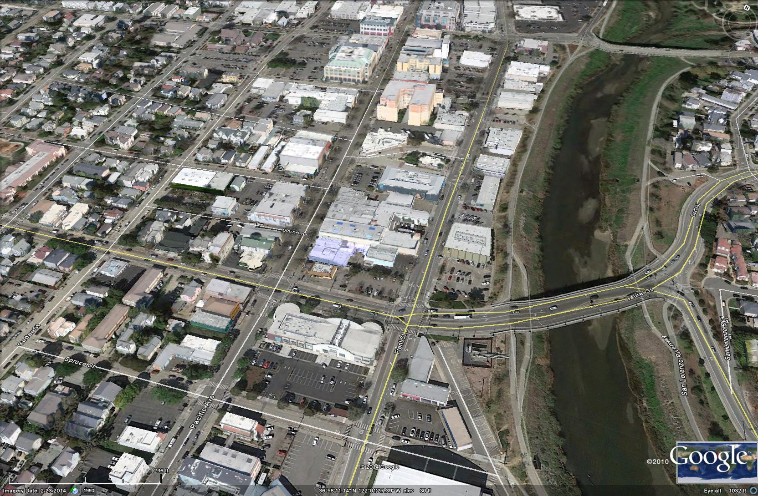
Downtown Recovery Plan
Development Standard Amendments
Santa Cruz Planning Commission
July 21, 2016

Slide 2
Presentation and Discussion
  Overview of Plan Organization and Changes
  Summary of PC Ad-Hoc Committee Discussion
    Review of language discussed by committee
  Review Highlighted Text
  Public Hearing - Comments
  Discussion by Planning Commission

Slide 3
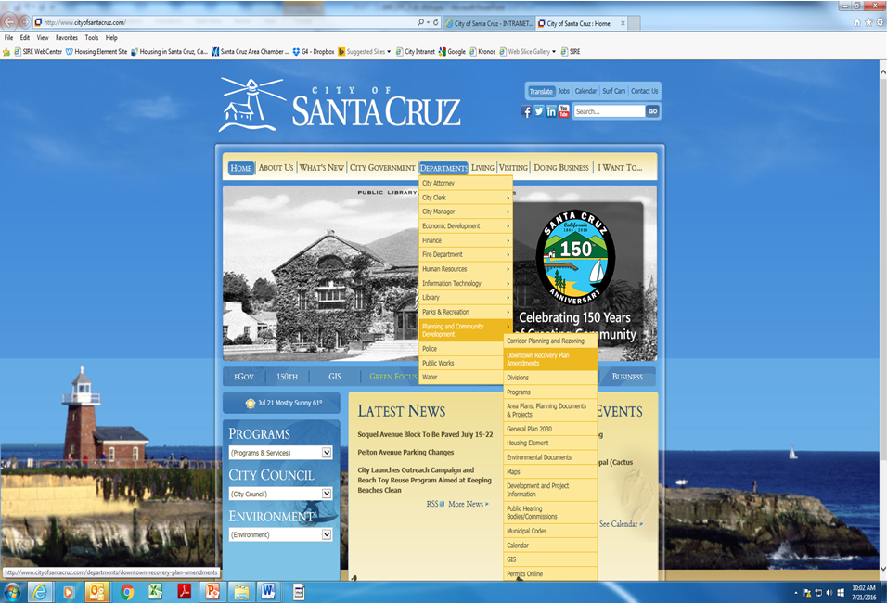
Documents Available for Public Review

Slide 4
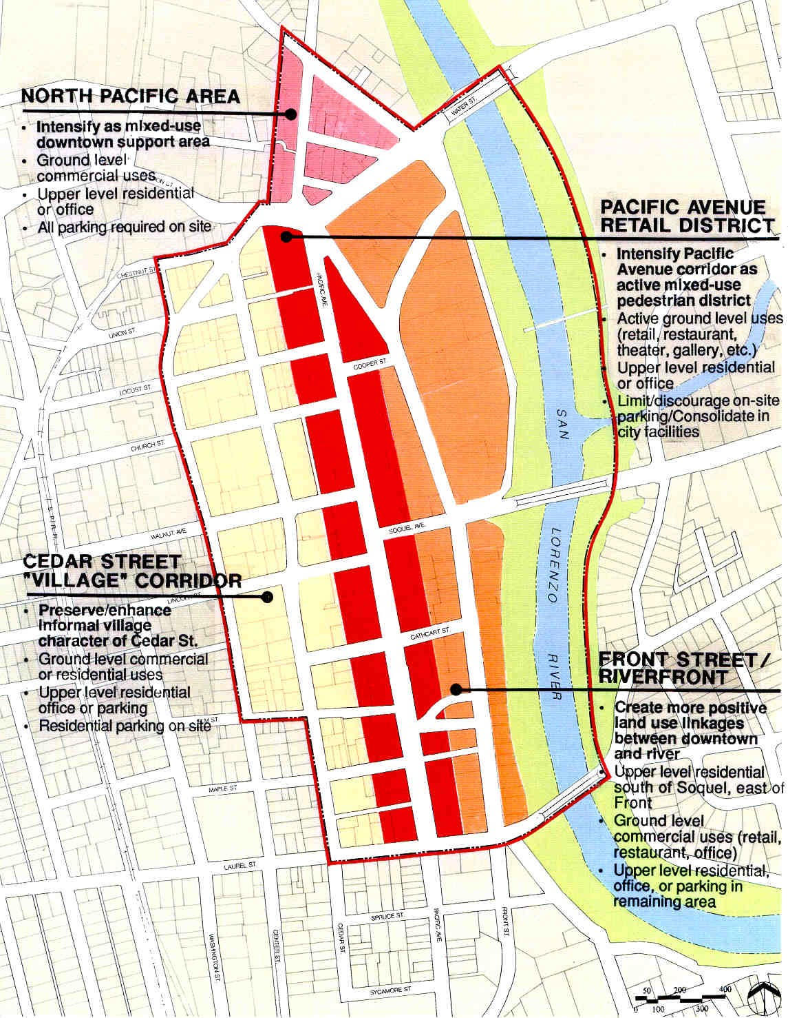
The Four Downtown Districts

Slide 5
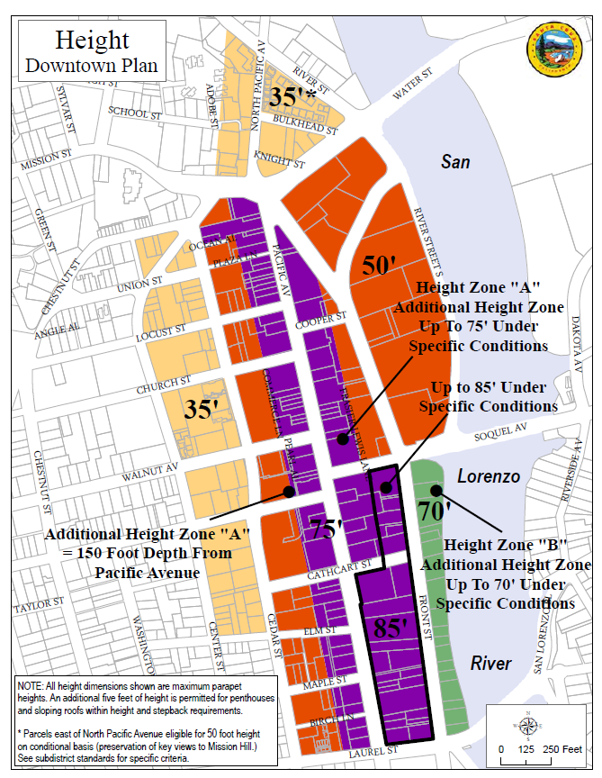
Focus Area of Amendments – Additional Height Zones

Slide 6
Summary of Ad-Hoc Committee Discussion
PACIFIC AVENUE RETAIL DISTRICT – BUILDING FAÇADE STANDARDS AND DESIGN GUIDELINES
Page 16 – Clean Version
7. RoofsSkyline Architectural Variations. Special attention shall be paid to the articulation of the top portion of buildings, through the introduction of such as variation in height, massing, materials, horizontal bands, cornices and/or decorative parapets. Rooflines shall be broken at intervals no greater than 50 to 60 feet by roof elements or step backs to reinforce the predominant building increment along Pacific Avenue. Interesting and varied roof forms are encouraged. Rooftop equipment shall be completely concealed from view and integrated within the architectural vocabulary of the building. The use of landscaped roof terraces and gardens is also recommended, particularly on buildings that are required to step back from the street.

Slide 7
Summary of Ad-Hoc Committee Discussion
FRONT STREET/RIVERFRONT CORRIDOR – DEVELOPMENT STANDARDS AND DESIGN GUIDELINES
Page 23 – Clean Version
4. Riverwalk Promenade
e. Lease/Easement onf Public Space. The City shall consider negotiated leases or easements on the publicly owned land on the west side of the Riverwalk for open space purposes that promote activity and overlook the promenade and river. Easements may be considered for up to 20 feet of the levee bank for such open space. The publically accessible open space area shall be visually open and accessible from the Riverwalk, but may be delineated with a low fence or hedge no more than 24 inches in height.

Slide 8
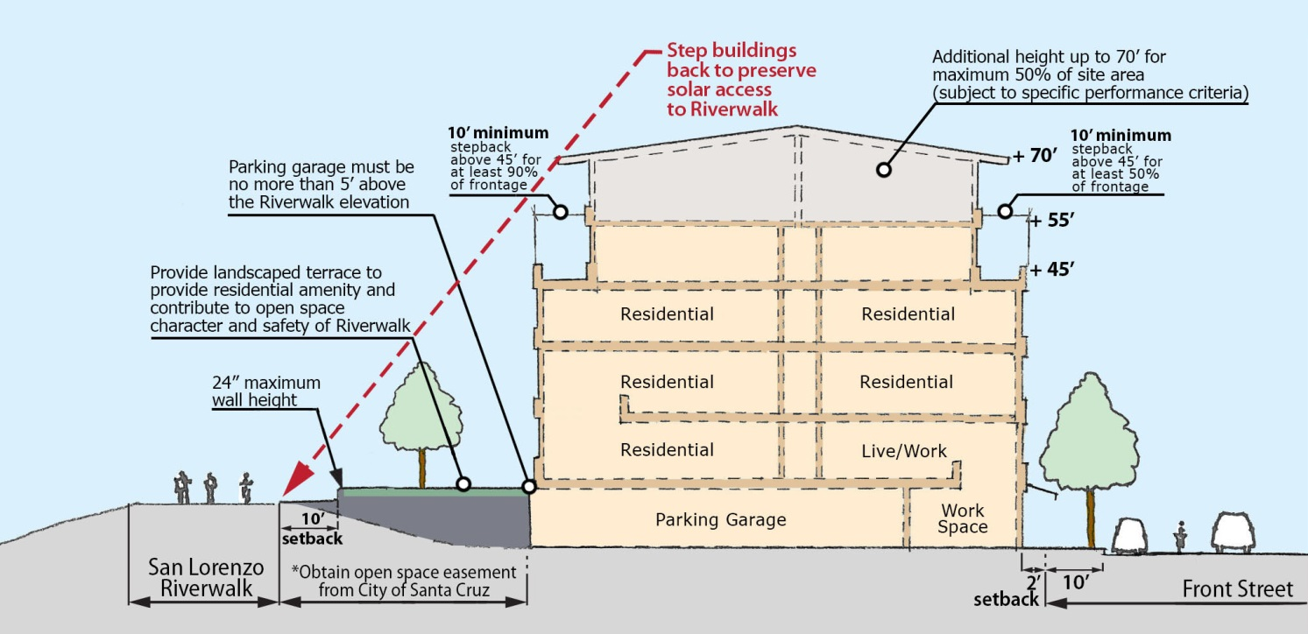
Summary of Ad-Hoc Committee Discussion
FRONT STREET/RIVERFRONT CORRIDOR – DEVELOPMENT STANDARDS AND DESIGN GUIDELINES
Riverwalk Promenade

Slide 9
Summary of Ad-Hoc Committee Discussion
ADDITIONAL HEIGHT ZONES
Page 42-43 – Clean Version
Additional Height Zone B
d. Performance Criteria
ii. Skyline Architectural Variation. In order to provide for variation of the skyline, the top floor area (measured from the exterior walls) shall not exceed 50% of the total building footprint and the top floor shall not exceed 60% of the building frontage width as measured along Front Street or the Riverwalk.
iii. Integrated Rooftop Design. Rooftops shall be fully designed and creatively integrated into the function of the building. Use of rRooftops provide opportunities as usable open spaces for building uses, community gardens, rainwater retention facilities, green-roof landscaping, solar panel facilities as shade structures, building mechanical equipment and other uses. These spaces shall be thoughtfully and creatively designed as part of the initial project application.

Slide 10
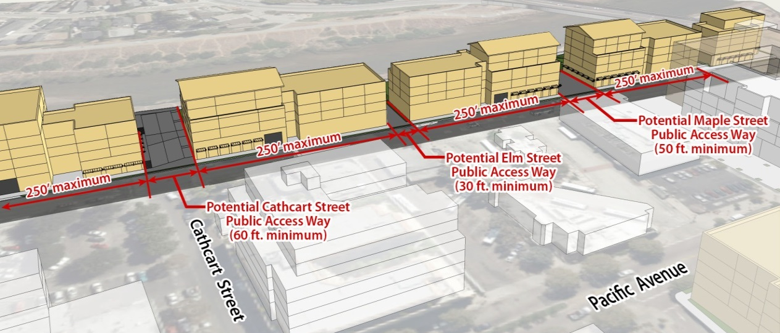
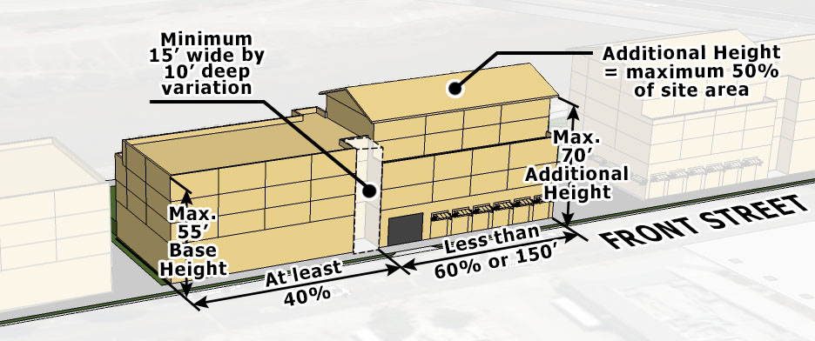
Summary of Ad-Hoc Committee Discussion
ADDITIONAL HEIGHT ZONES
Skyline Architectural Variation and Integrated Rooftop Design

Slide 11
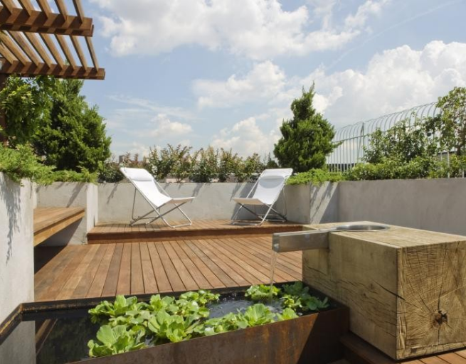
Summary of Ad-Hoc Committee Discussion
ADDITIONAL HEIGHT ZONES
Skyline Architectural Variation and Integrated Rooftop Design

Slide 12
Presentation and Discussion
  Review Highlighted Text
    San Lorenzo Urban River Plan Policies
  Public Hearing - Comments
  Discussion by Planning Commission

