Slide 1
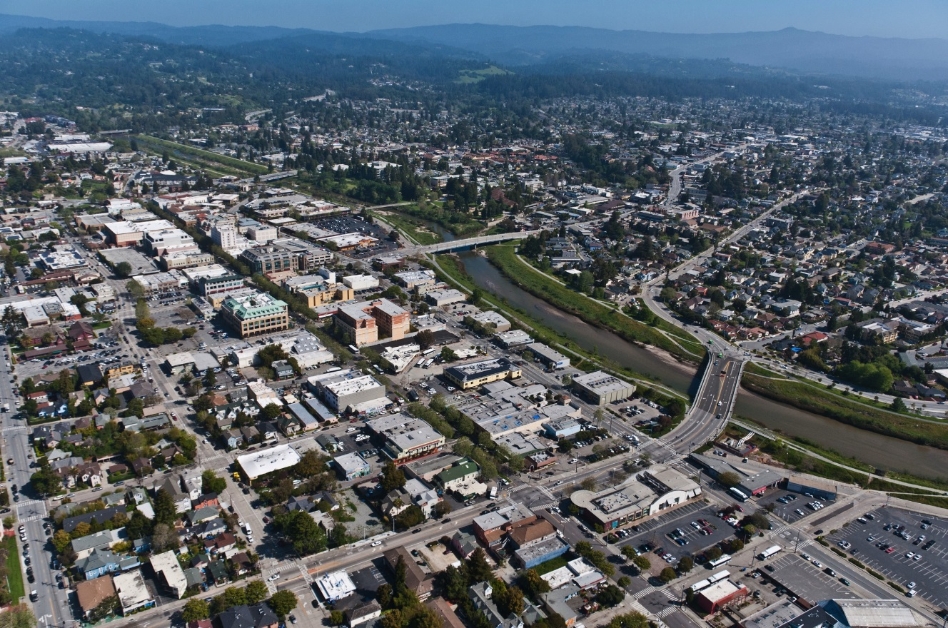
DOWNTOWN PLAN UPDATE
RECOMMENDED DEVELOPMENT STANDARD AMENDMENTS
Presentation to the City Council
Prepared by ROMA Design Group and McCann Adams Studio
May 10, 2016

Slide 2
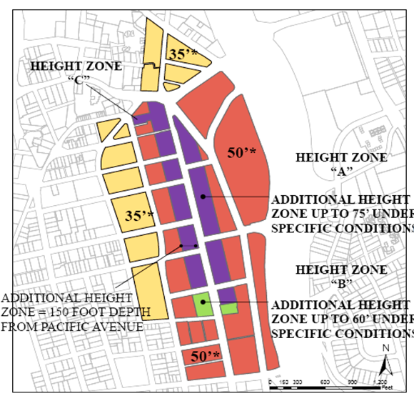
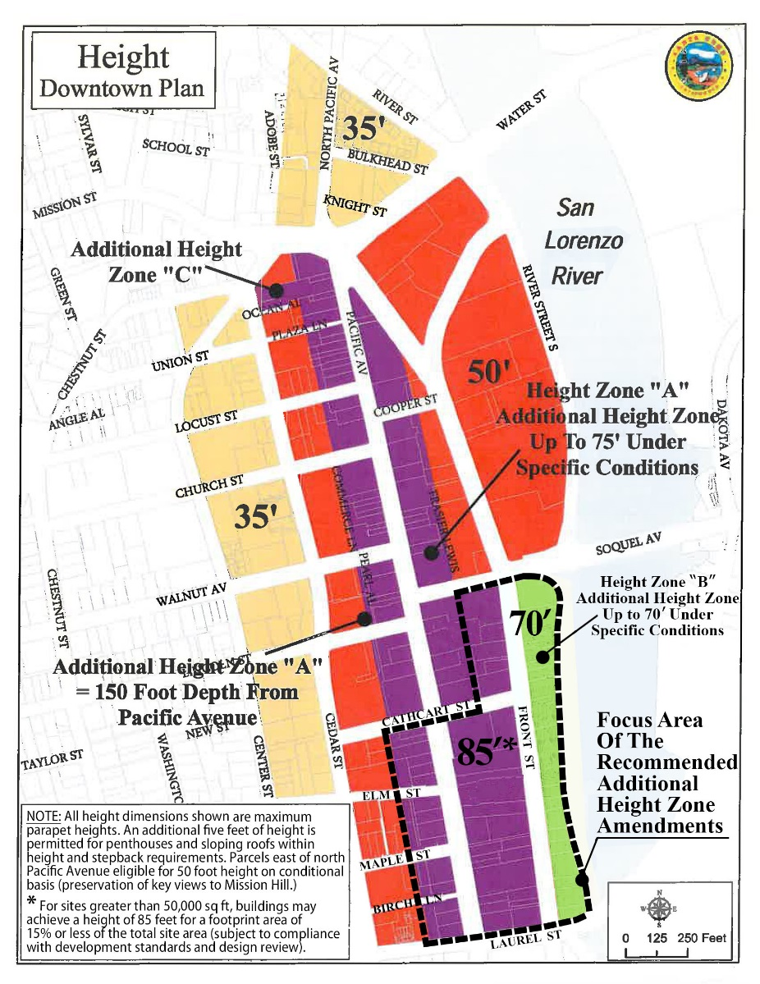
Allow Additional Height for Eligible Sites
Existing Height Map
Proposed Height Map Amendment
Existing Height Map
Proposed Amendments
SANTA CRUZ DOWNTOWN PLAN UPDATE
December 3, 2015
Pacific Avenue Retail District Development Standards
Proposed Additional Height Standards

Slide 3
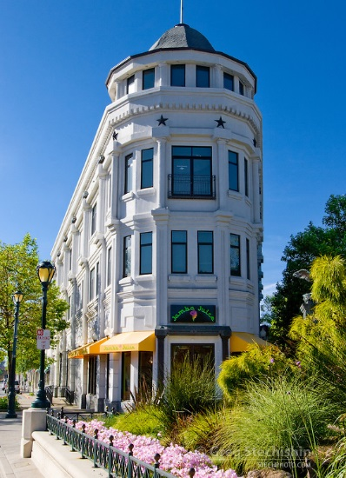
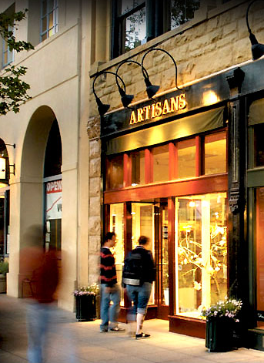
Extend the Scale and Vitality of Downtown South of Cathcart Street
SANTA CRUZ DOWNTOWN PLAN UPDATE
December 3, 2015
General Findings and Recommendations
Downtown Recovery Plan
Notes:
The focus of this work includes Pacific Avenue between Cathcart Street and Laurel Street and Front Street south of Soquel Avenue, where the City is encouraging the extension of downtown growth in a way that maintains the vitality and scale of upper Pacific Avenue.
The lower Pacific Avenue and riverfront properties east of Front Street and south of Soquel Avenue have remained undeveloped and underutilized for many years.
The City wishes to revisit the development standards of the DRP to ensure that they provide appropriate guidance and sufficient incentive to achieve the goals for Downtown and to ensure a high quality environment.
As we discussed in December, we believe that the additional height that is offered to eligible properties north of Cathcart Street should be made available to properties south of Cathcart Street as a means of achieving this goal.

Slide 4
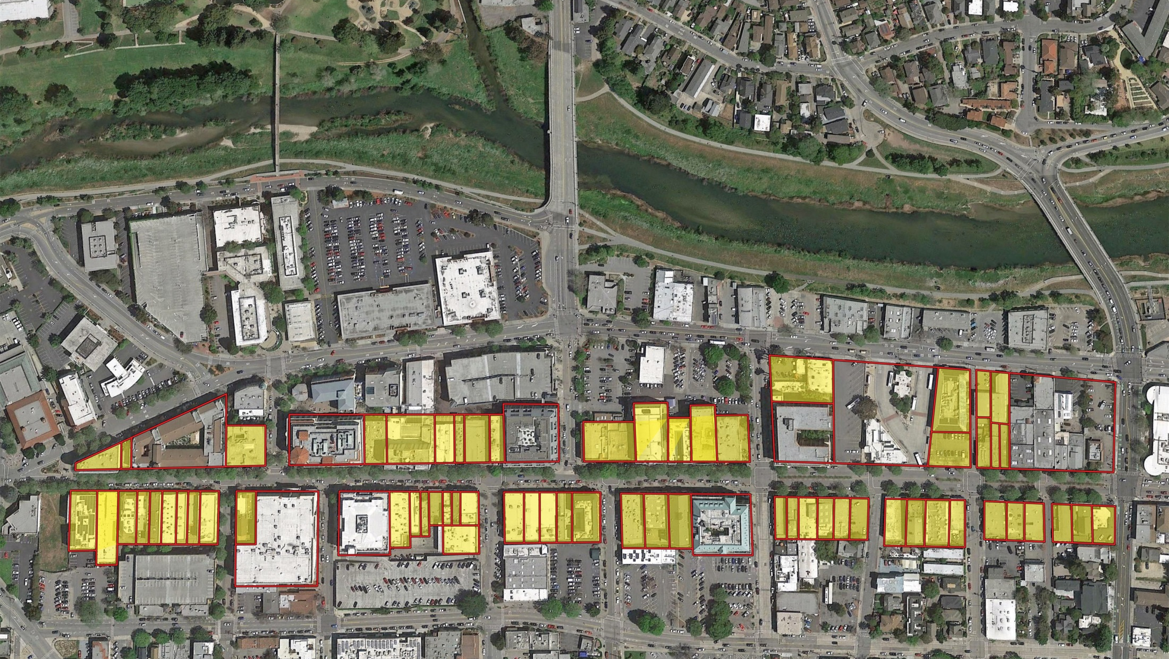
Existing Pattern of Small Lots Downtown
Include diagram from page 4 of memo.
More than 85% of Pacific Avenue sites are less than 6,000 square feet in size. Only seven have been eligible for additional height, and these have all been approximately 20,000 square feet.
Notes:
The standards are aimed at avoiding the walling off of the river, by promoting additional access ways between Front Street and the river, near the foot of Cathcart and the extensions of Maple and Elm Streets.

Slide 5
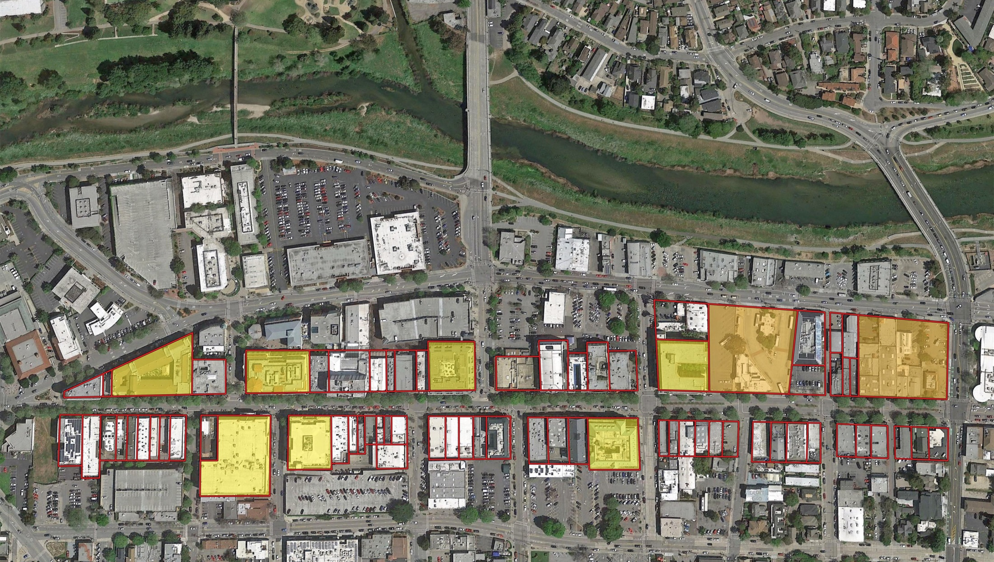
Large Assembled Sites South of Cathcart Street
Include diagram from page 4 of memo.
More than 85% of Pacific Avenue sites are less than 6,000 square feet in size. Only seven have been eligible for additional height, and these have all been approximately 20,000 square feet.
Notes:
The standards are aimed at avoiding the walling off of the river, by promoting additional access ways between Front Street and the river, near the foot of Cathcart and the extensions of Maple and Elm Streets.

Slide 6
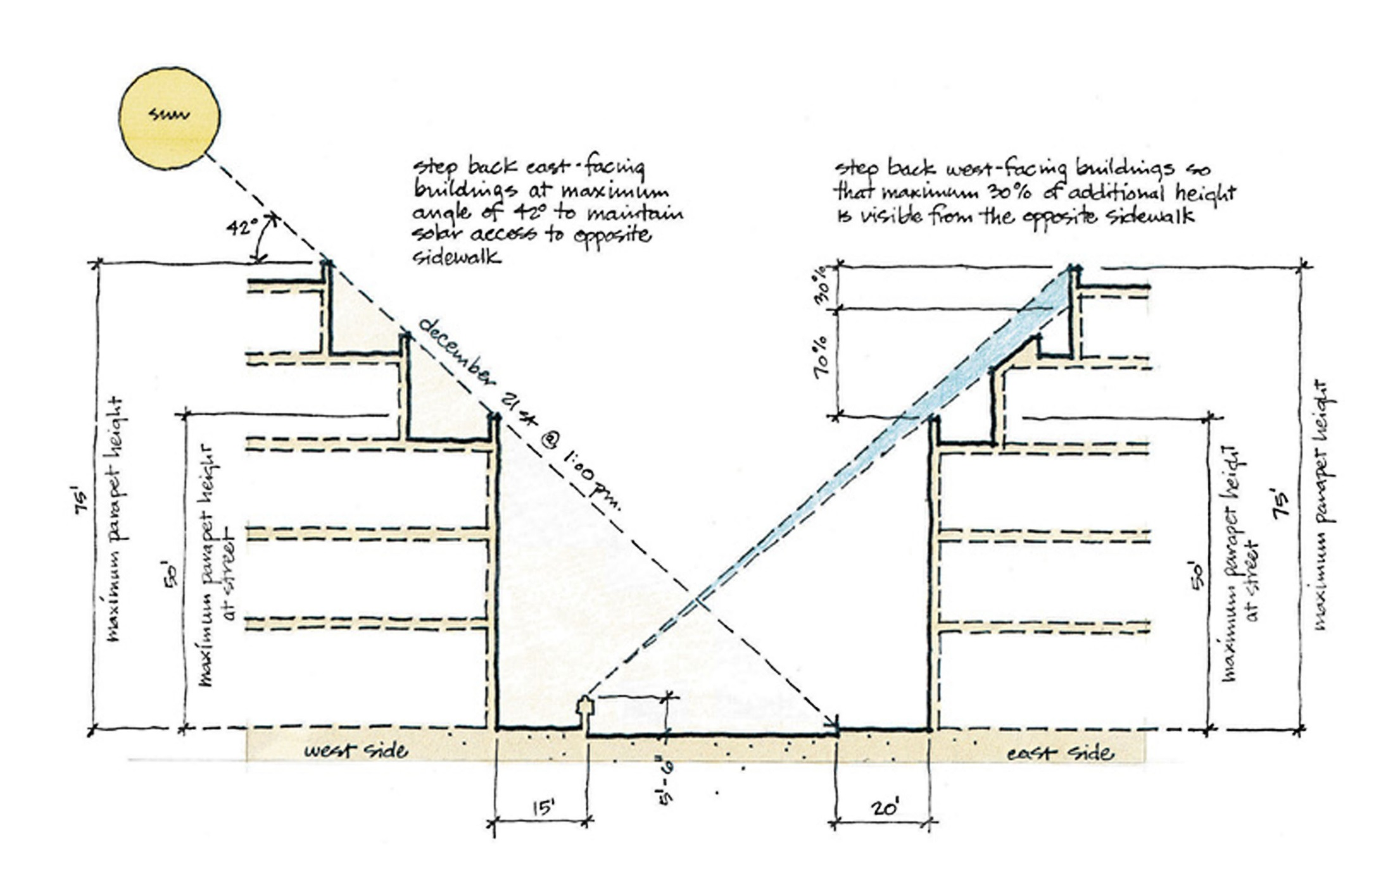
Stepbacks will not Achieve the Desired Result South of Cathcart
The existing setback regulations north of Cathcart Street are not suited
to the large assembled blocks south of Cathcart Street.

Slide 7
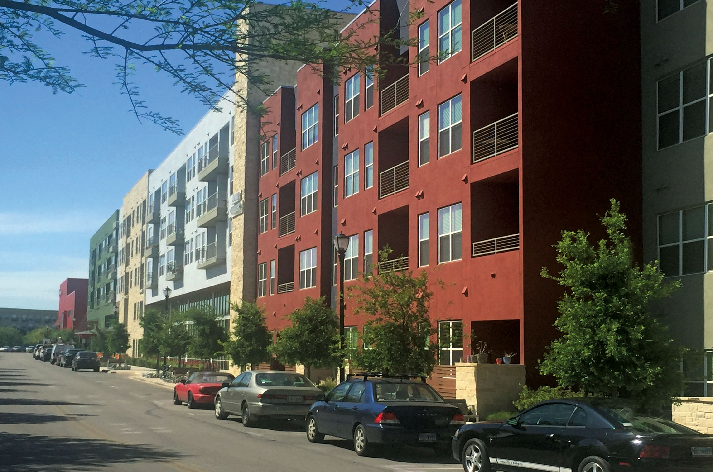
Articulation and Material Changes are Insufficient to Reduce Scale
SANTA CRUZ DOWNTOWN PLAN UPDATE
December 3, 2015
General Findings and Recommendations
Broadway Family Apartment Complex (Dan Solomon)
Notes:
Contrast this volumetric approach with an approach that focuses on building articulation through changes of material, balconies, etc.
We are concerned that this approach would not create the more intricate and interesting town scale environment that makes Downtown Santa Cruz so unique and charming.

Slide 8
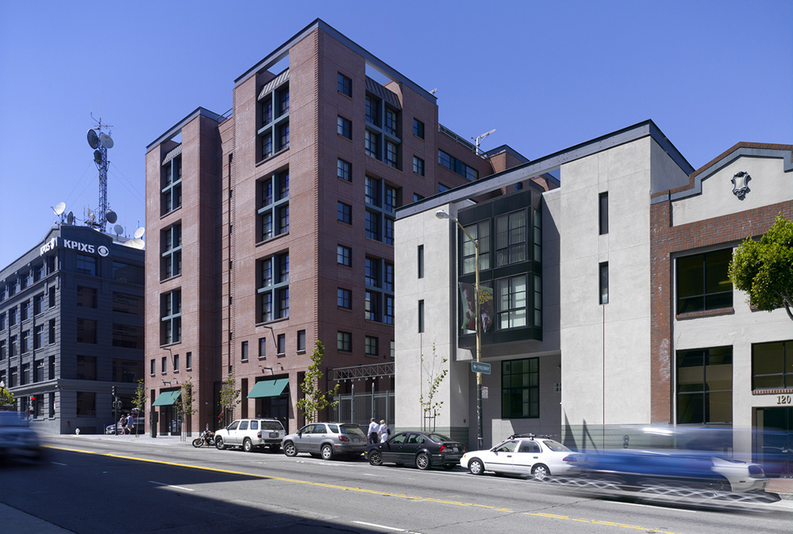
Promote a Volumetric Approach with Horizontal and Vertical Variation
SANTA CRUZ DOWNTOWN PLAN UPDATE
December 3, 2015
General Findings and Recommendations
Broadway Family Apartment Complex (Dan Solomon)
Notes:
Rather than relying on building stepbacks and terracing to achieve an appropriate scale transition to smaller buildings, the proposed standards call for horizontal and vertical variation to create the appearance of multiple buildings that are more in keeping with the surrounding area.
We believe that additional height – even up to 85 feet like the Palomar – can be absorbed appropriately if it is confined to a portion of a property, rather than as a massive block, terraced back from the street.

Slide 9
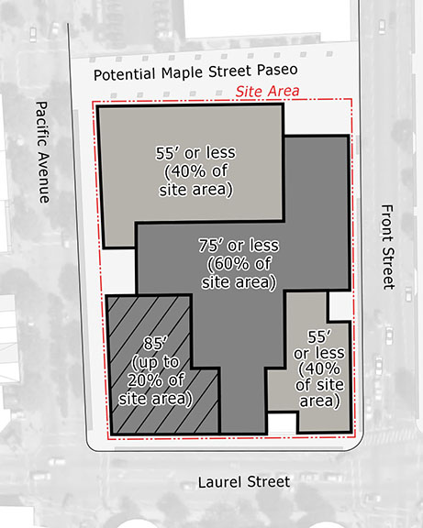
Pacific Avenue Retail District Development Standards: Additional Height
ON SITES GREATER THAN 50,000 sq ft:
At least 40% of site area must be at or below the 55-foot maximum base height
Up to 60% of the site area may achieve a height of 75 feet
Up to 20% may achieve a height of 85 feet
ON SITES BETWEEN
20,000 and 50,000 sq ft:
At least 40% of site area must be at or below the 55-foot maximum base height
Up to 60% may achieve a height of 75 feet
SANTA CRUZ DOWNTOWN PLAN UPDATE
December 3, 2015
Pacific Avenue Retail District Development Standards
Proposed Height, Massing and Stepback Standards

Slide 10
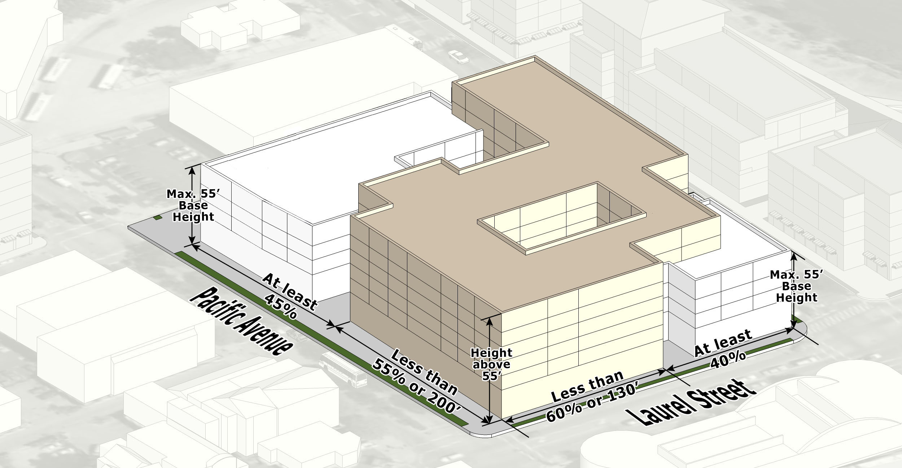
Pacific Avenue Retail District Development Standards: Additional Height
Limit the additional height along each of the street frontages.
SANTA CRUZ DOWNTOWN PLAN UPDATE
December 3, 2015
Pacific Avenue Retail District Development Standards
Proposed Height, Massing and Stepback Standards

Slide 11
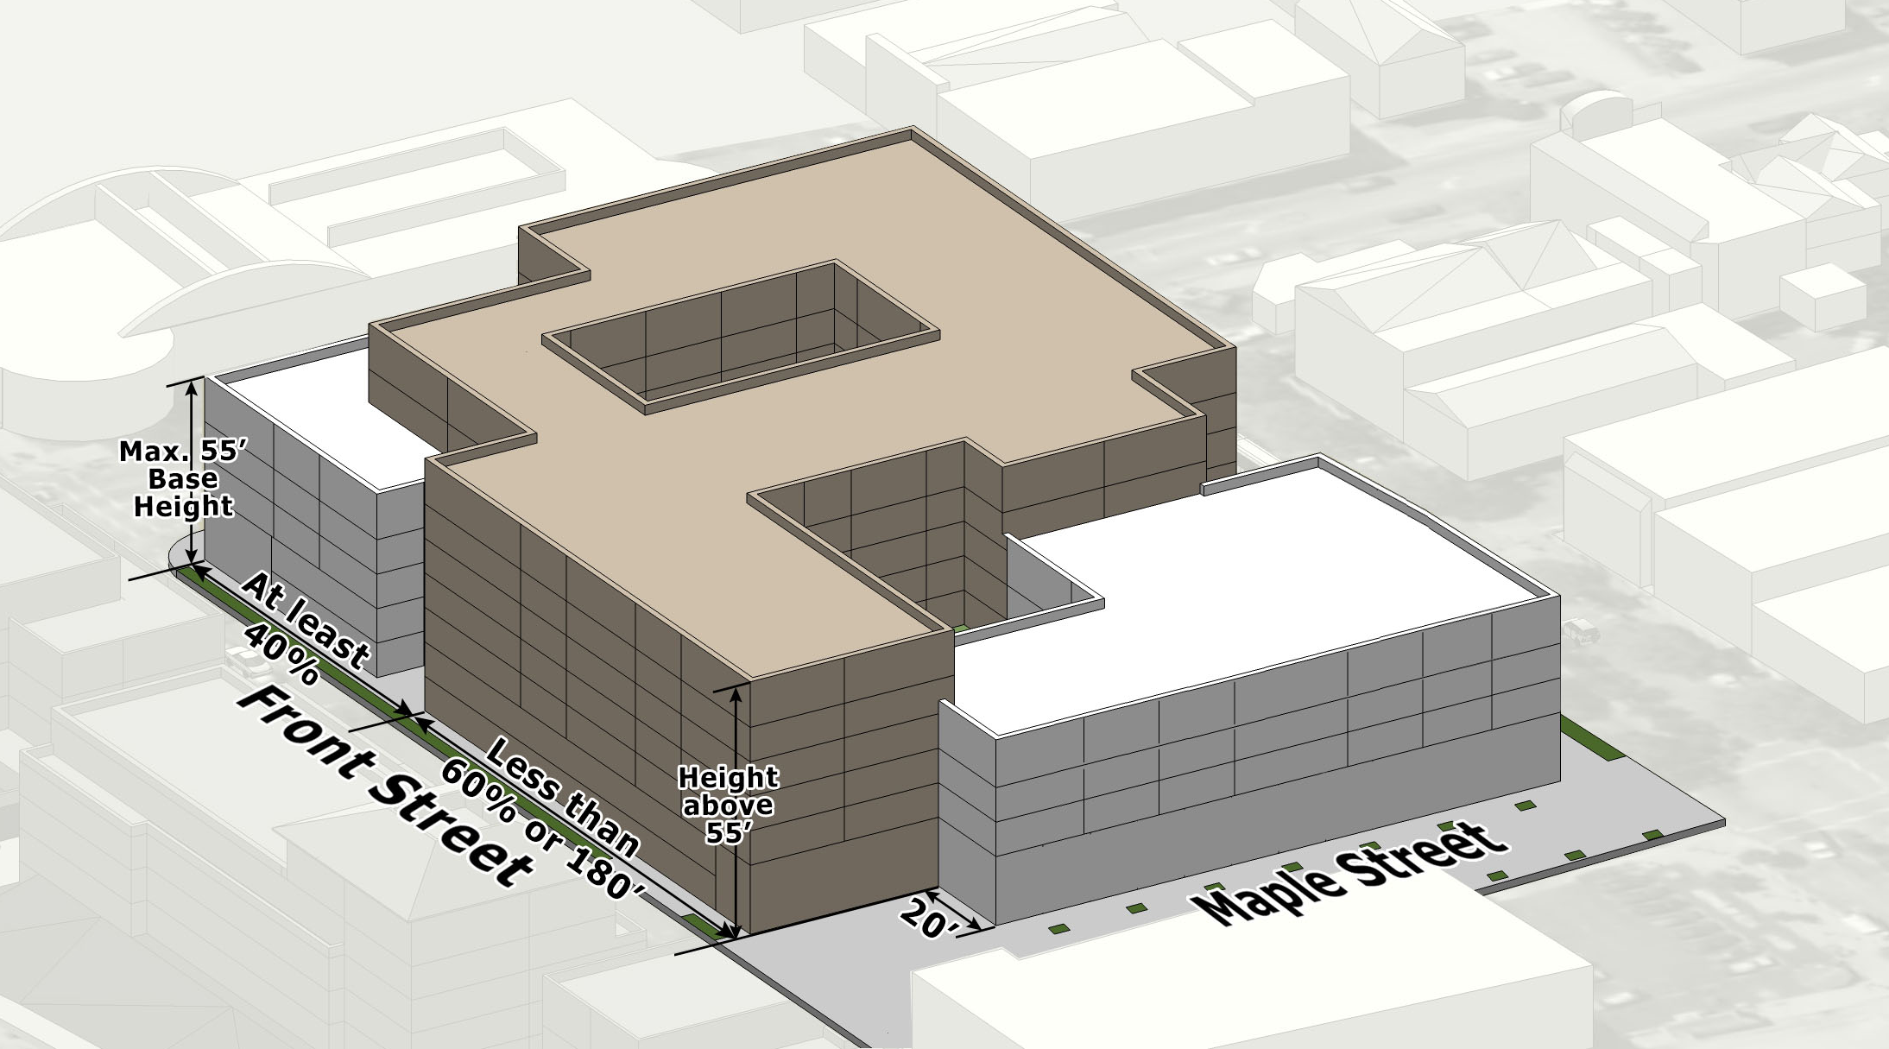
Pacific Avenue Retail District Development Standards: Additional Height
Limit the additional height along each of the street frontages.
SANTA CRUZ DOWNTOWN PLAN UPDATE
December 3, 2015
Pacific Avenue Retail District Development Standards
Proposed Height, Massing and Stepback Standards

Slide 12
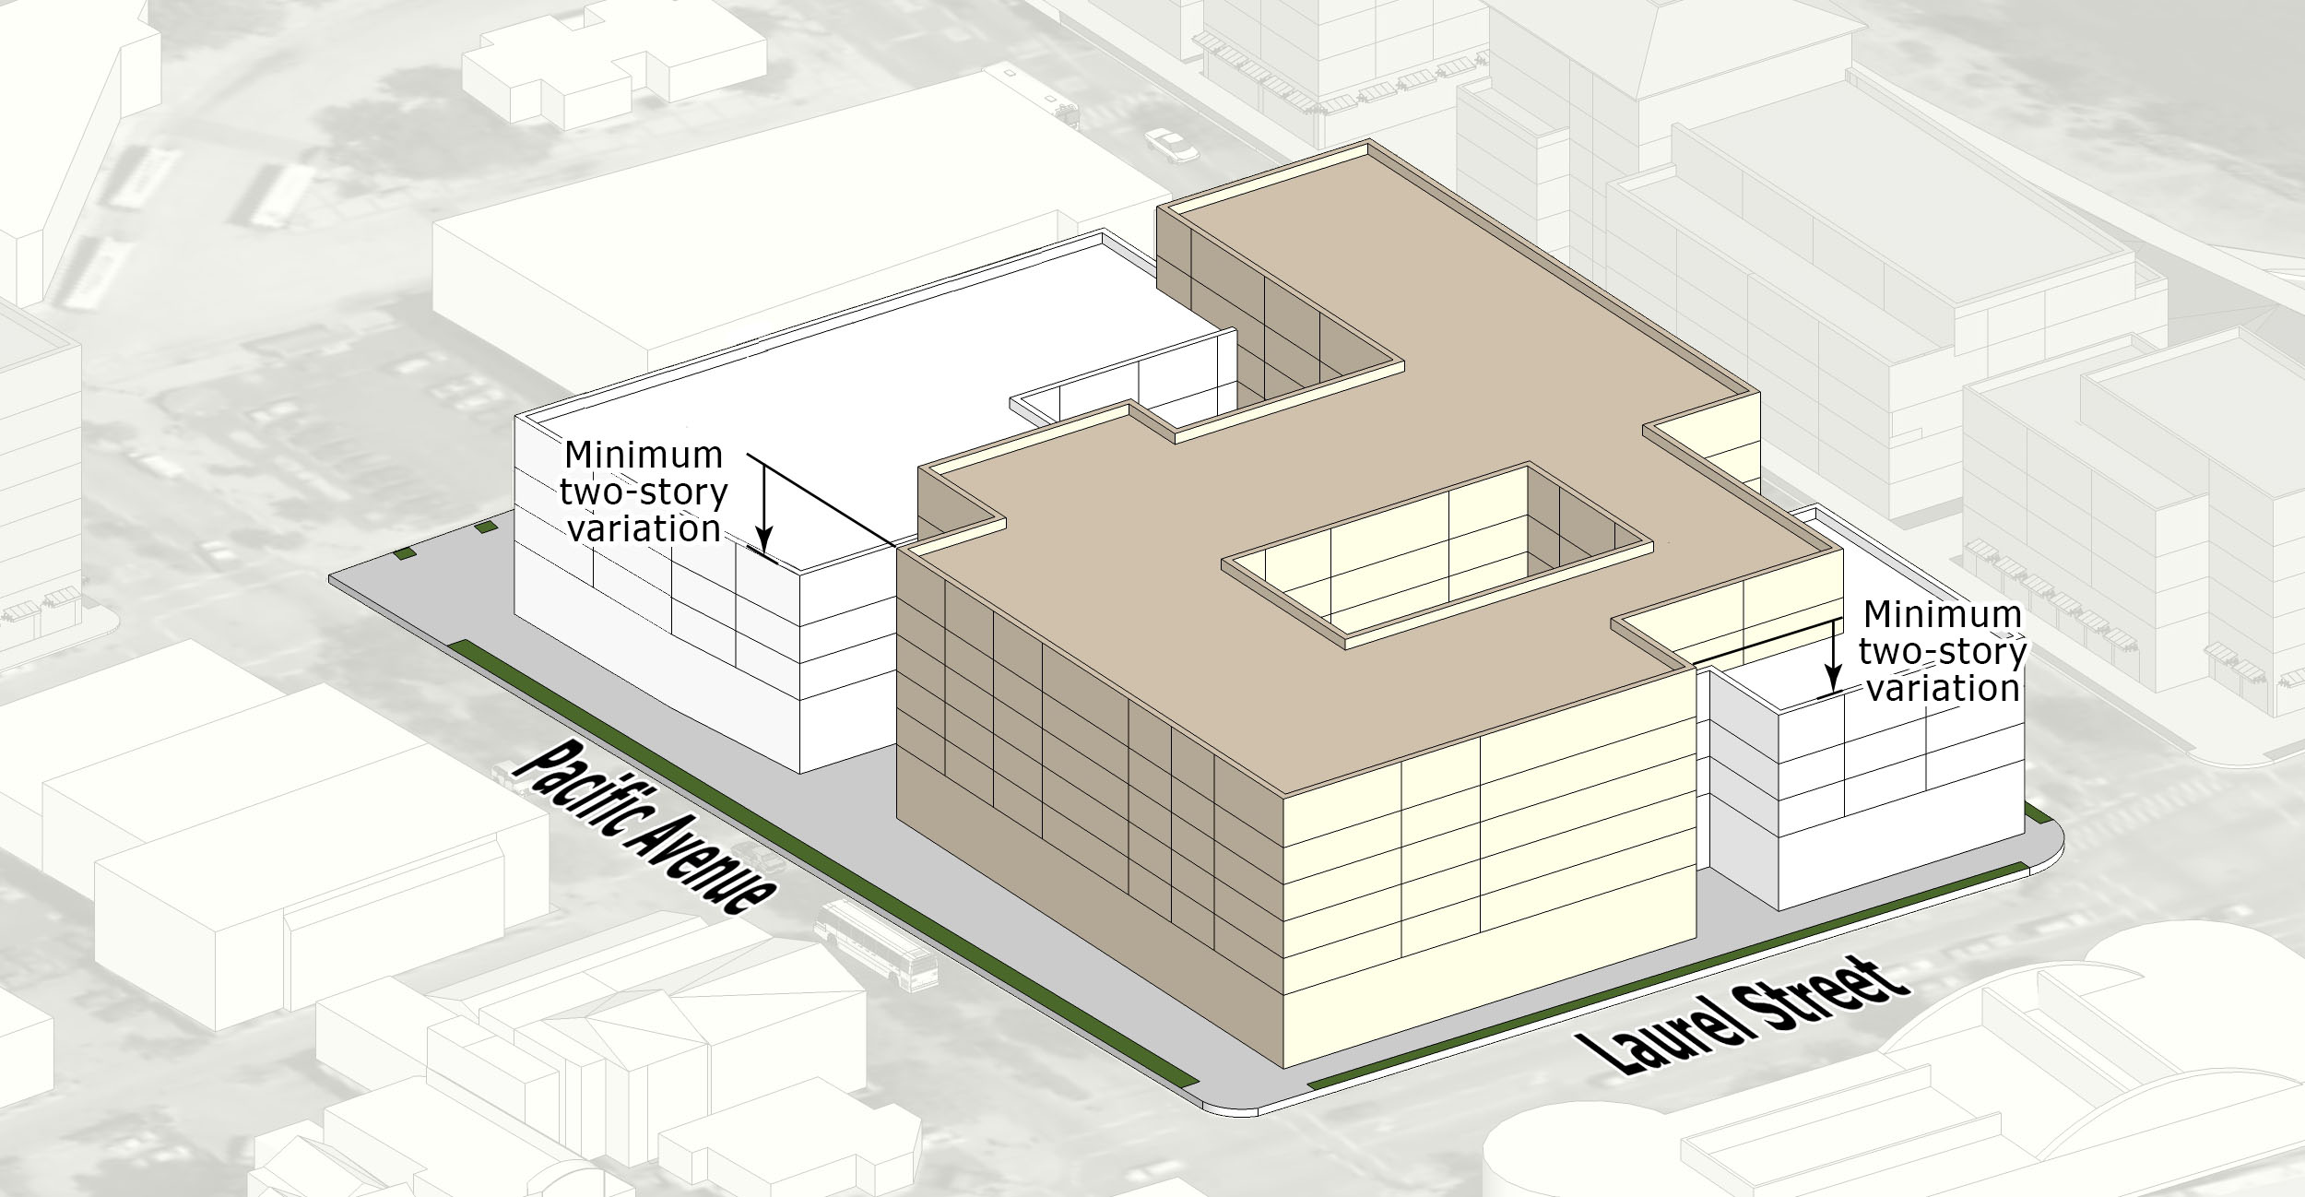
Pacific Avenue Retail District Development Standards: Additional Height
Create a two-story variation between building volumes.
SANTA CRUZ DOWNTOWN PLAN UPDATE
December 3, 2015
Pacific Avenue Retail District Development Standards
Proposed Height, Massing and Stepback Standards

Slide 13
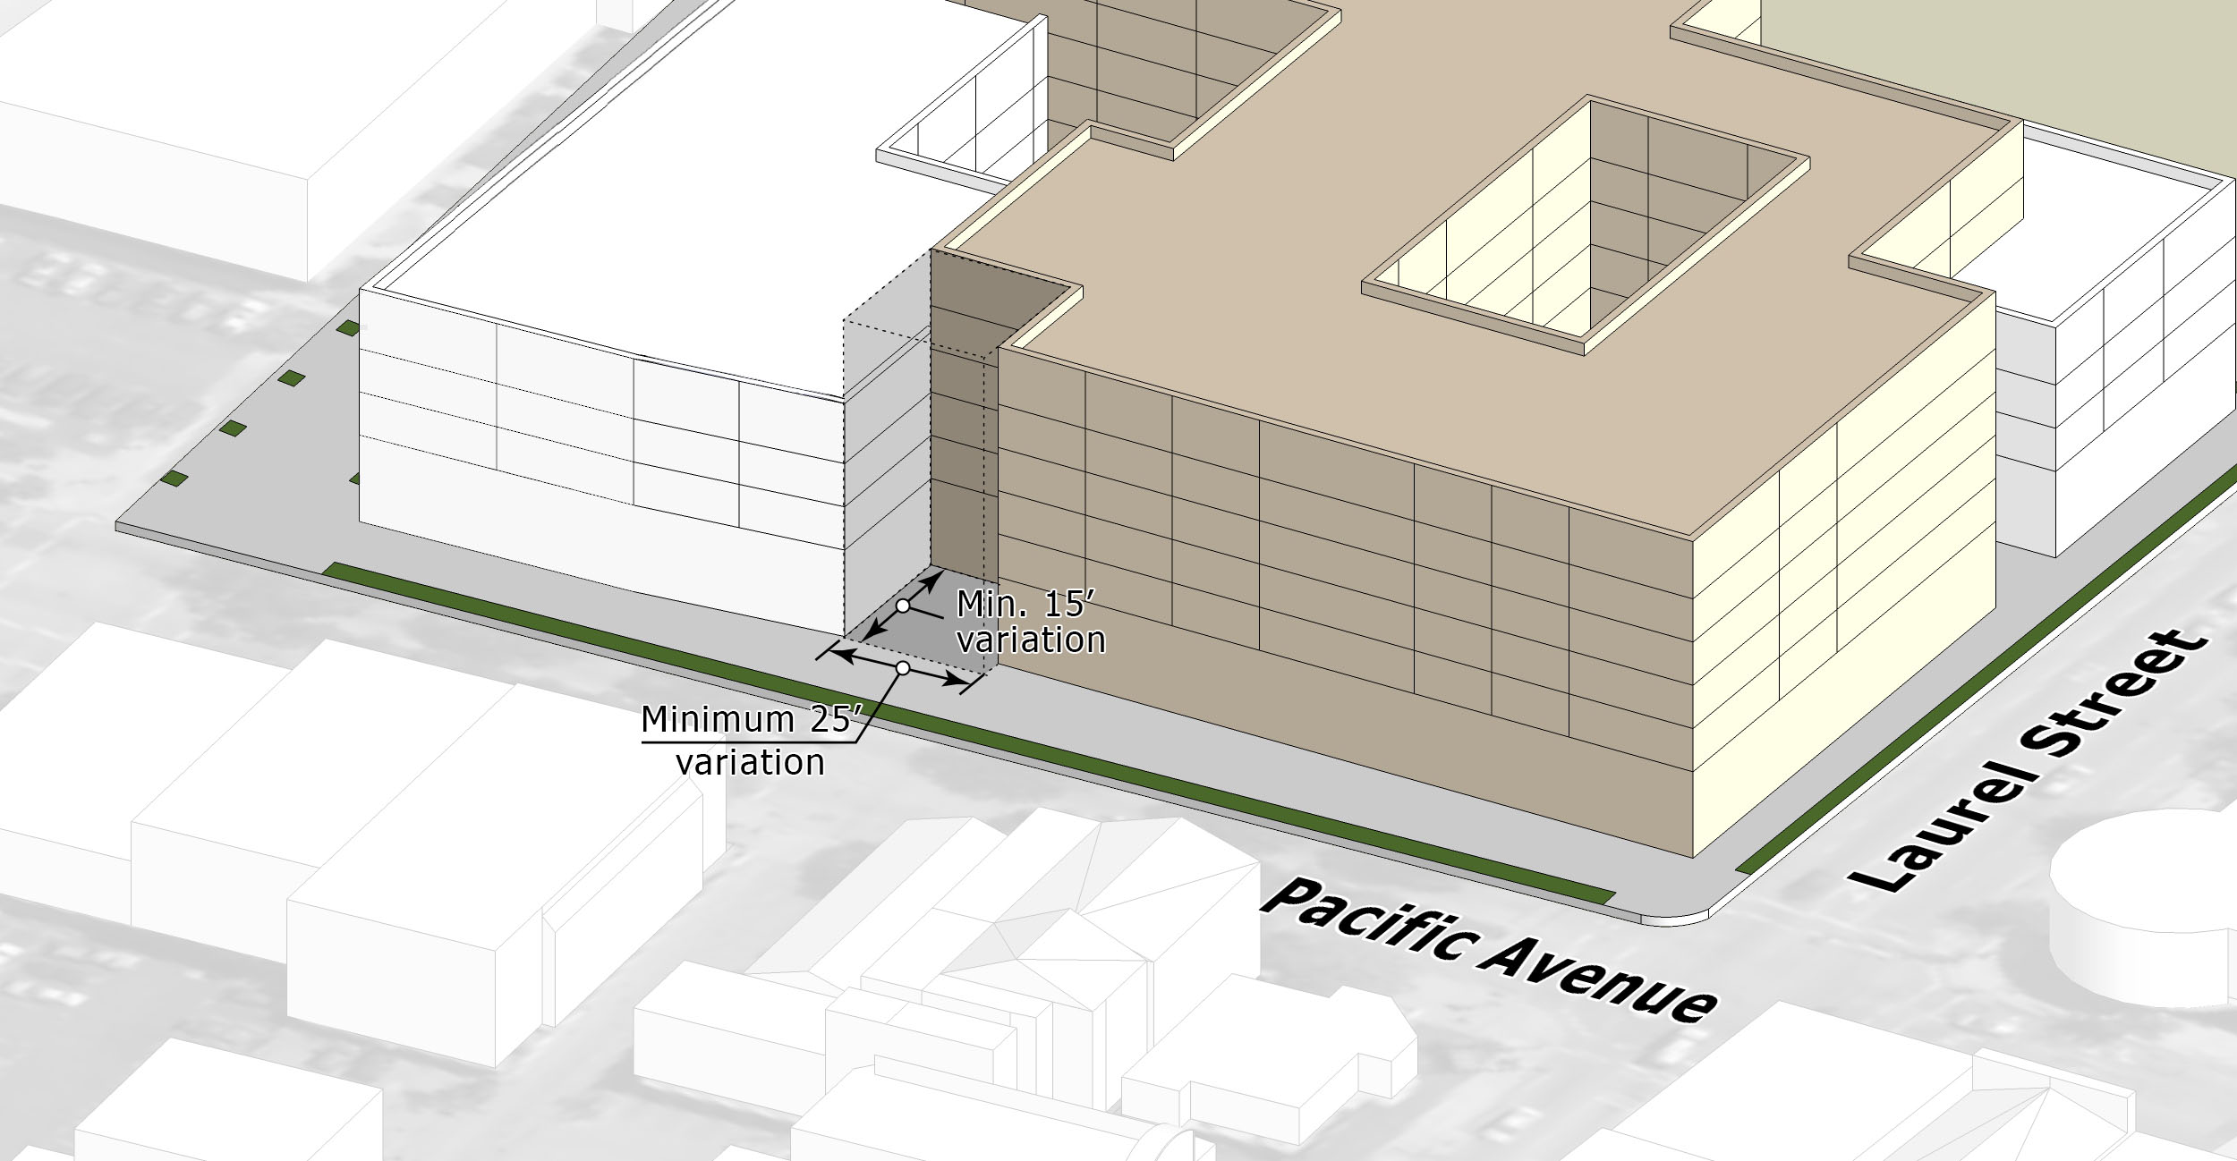
Pacific Avenue Retail District Development Standards: Additional Height
Establish a separation to provide a visual break between building volumes.
SANTA CRUZ DOWNTOWN PLAN UPDATE
December 3, 2015
Pacific Avenue Retail District Development Standards
Proposed Height, Massing and Stepback Standards

Slide 14
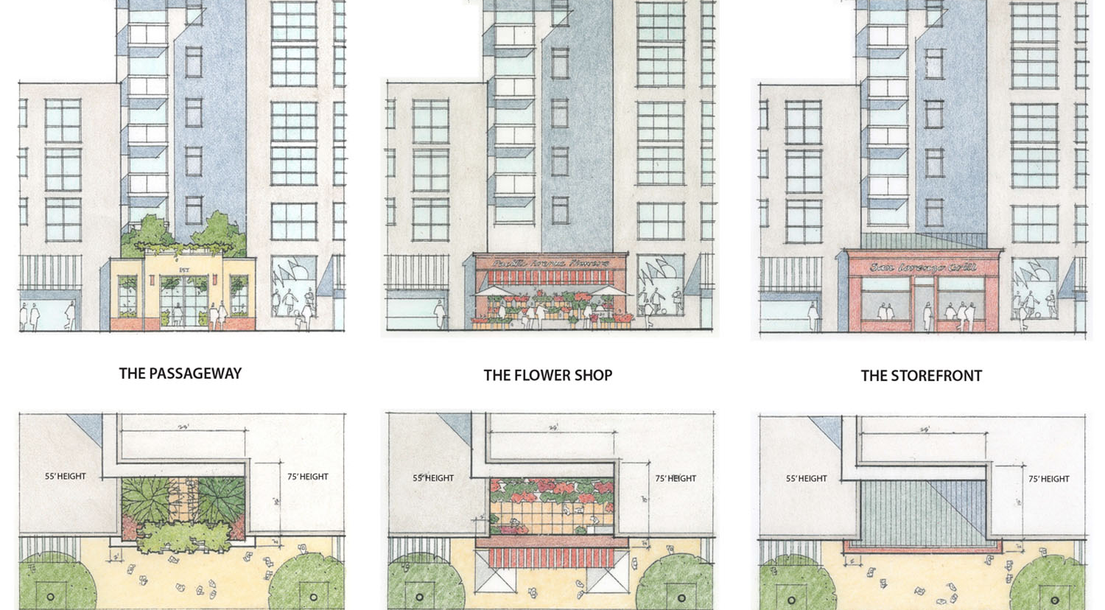
Pacific Avenue Retail District Development Standards: Additional Height
Ensure that the breaks contribute to a positive streetscape environment.
SANTA CRUZ DOWNTOWN PLAN UPDATE
December 3, 2015
Pacific Avenue Retail District Development Standards
Proposed Height, Massing and Stepback Standards

Slide 15
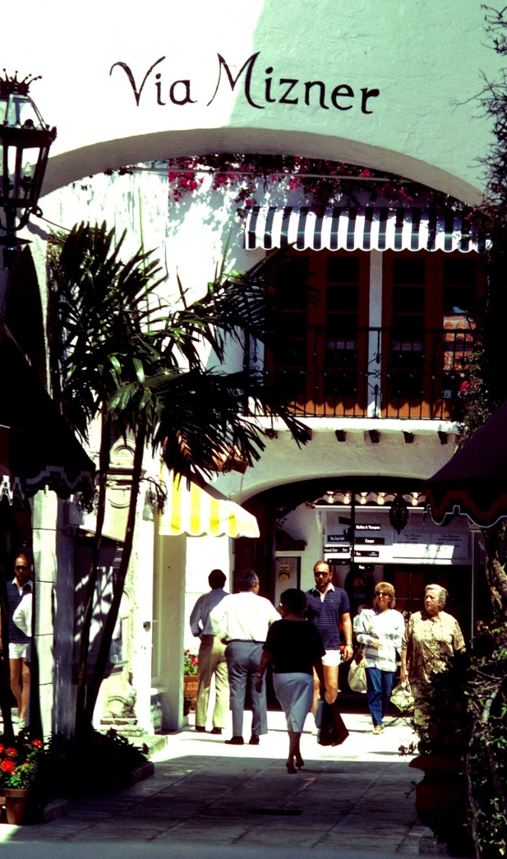
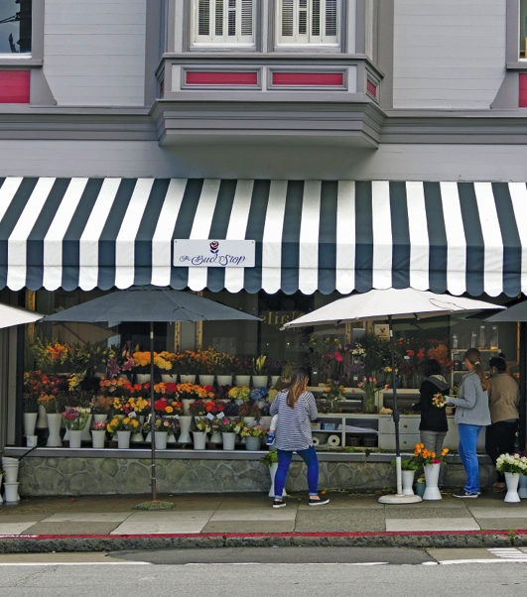
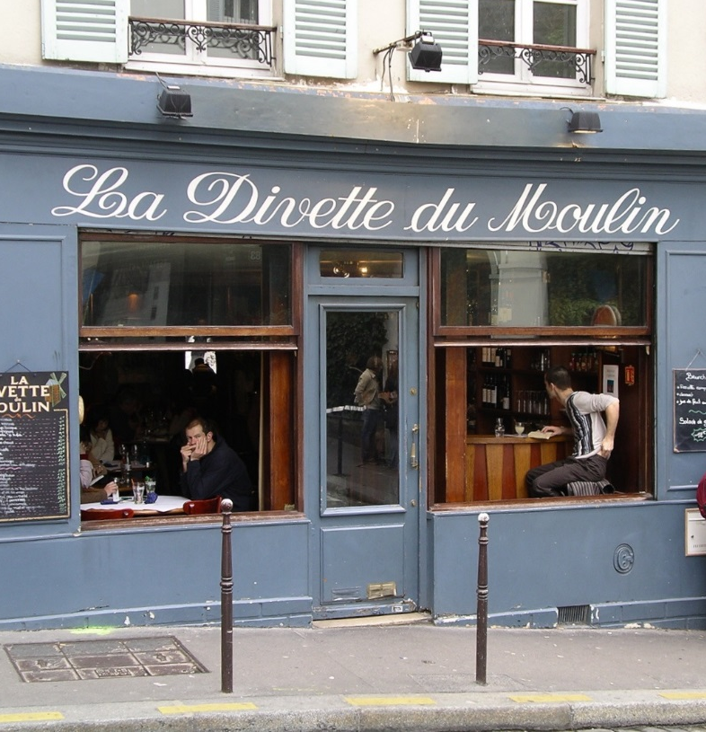
Pacific Avenue Retail District Development Standards: Additional Height
Flower Shop
Storefront
Ensure that the breaks contribute to a positive streetscape environment.
Through-Block Passageway

Slide 16
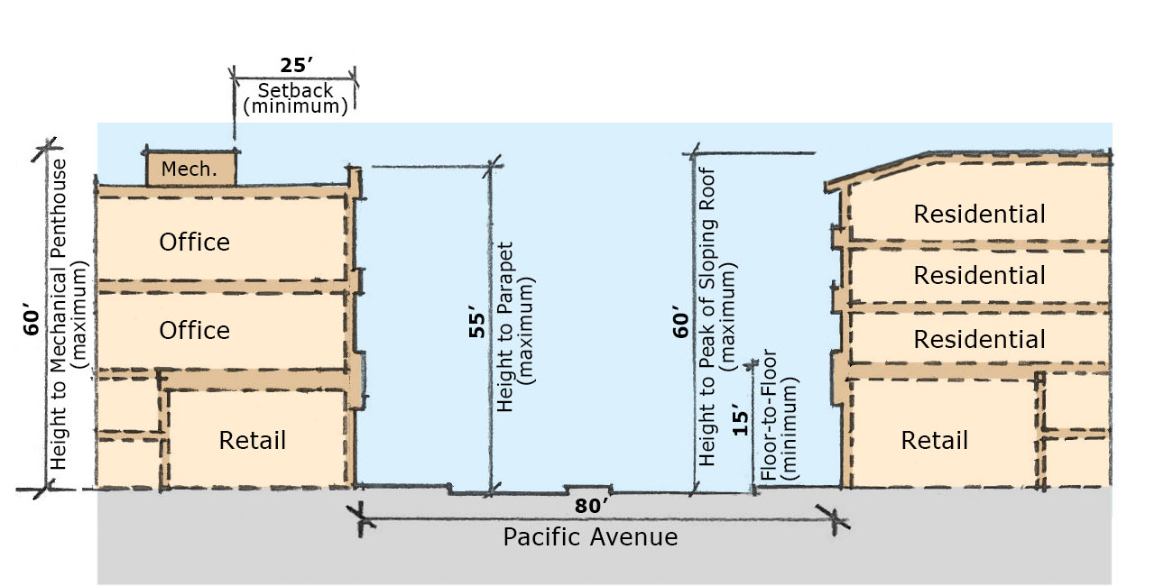
Pacific Avenue Retail District Development Standards: Base Height
Reduce the minimum ground level floor-to-floor height from 18’ to 15’
Increase the maximum base height from 50’ to 55’
Increase the maximum height of uninhabitable mechanical penthouses from 55’ to 60’
Increase the maximum height of sloping roofs from 55’ to 60’
Pacific Avenue Retail District Development Standards
Proposed Base Height and Stepback Requirements

Slide 17
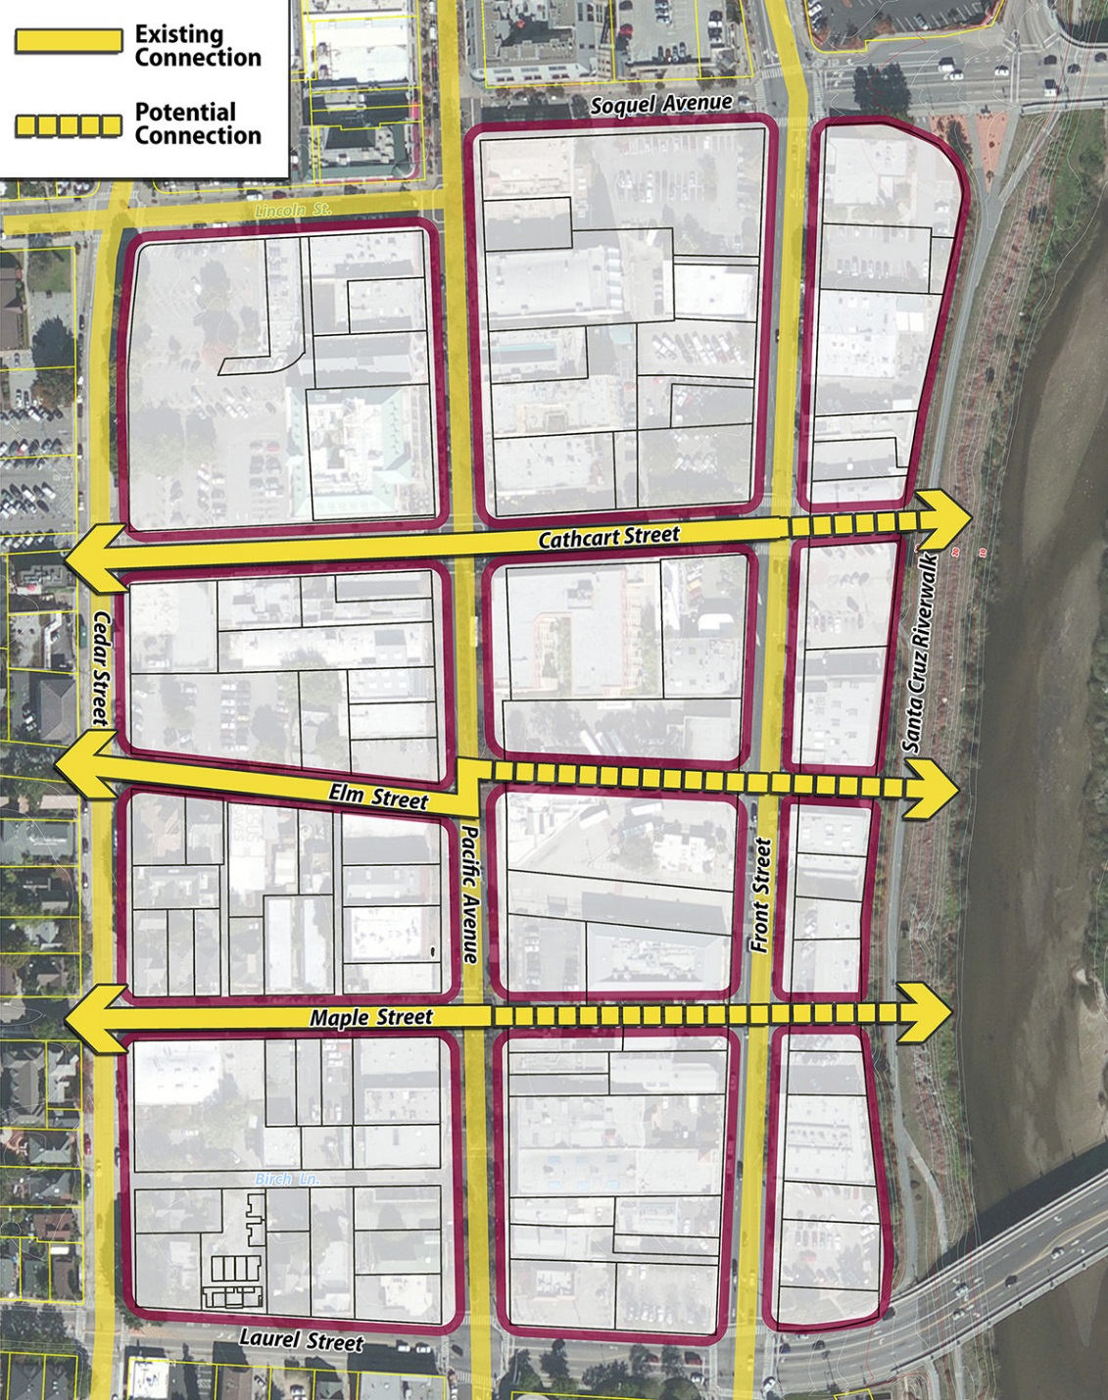
Linkages are Essential to the Riverfront’s Transformation
Include diagram from page 4 of memo.
Notes:
The standards are aimed at avoiding the walling off of the river, by promoting additional access ways between Front Street and the river, near the foot of Cathcart and the extensions of Maple and Elm Streets.

Slide 18
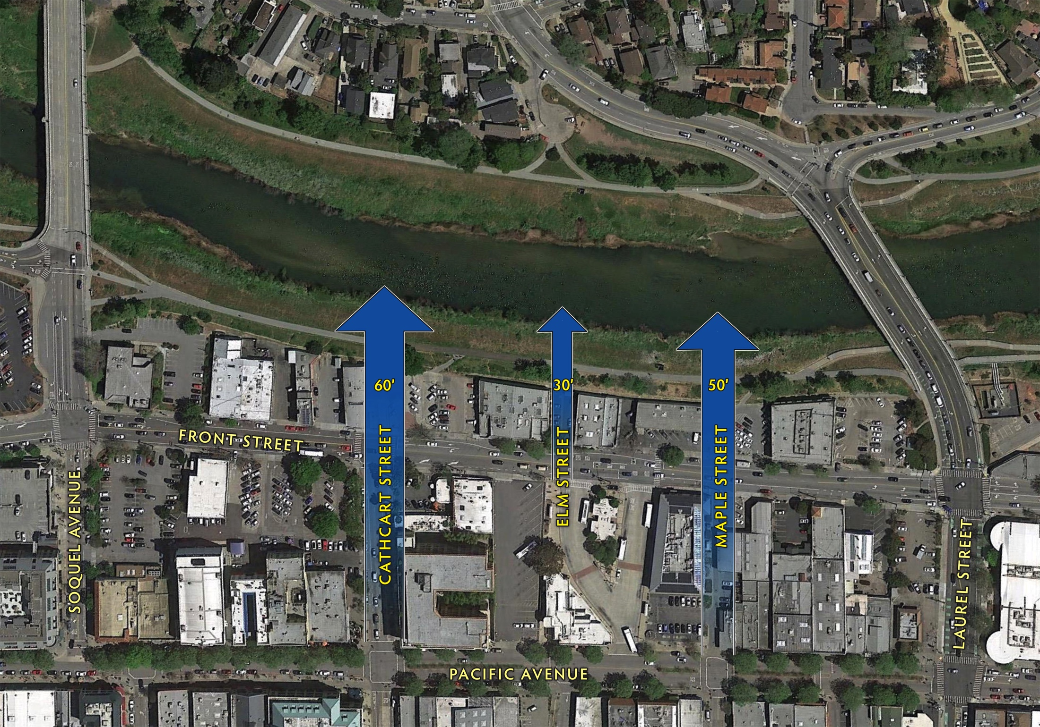
DOWNTOWN PLAN UPDATE
RECOMMENDED DEVELOPMENT
STANDARD AMENDMENTS
Presentation to the Planning Commission
San Lorenzo Riverfront Linkages
Prepared by: ROMA Design Group and McCann Adams Studio
December 3, 2015

Slide 19
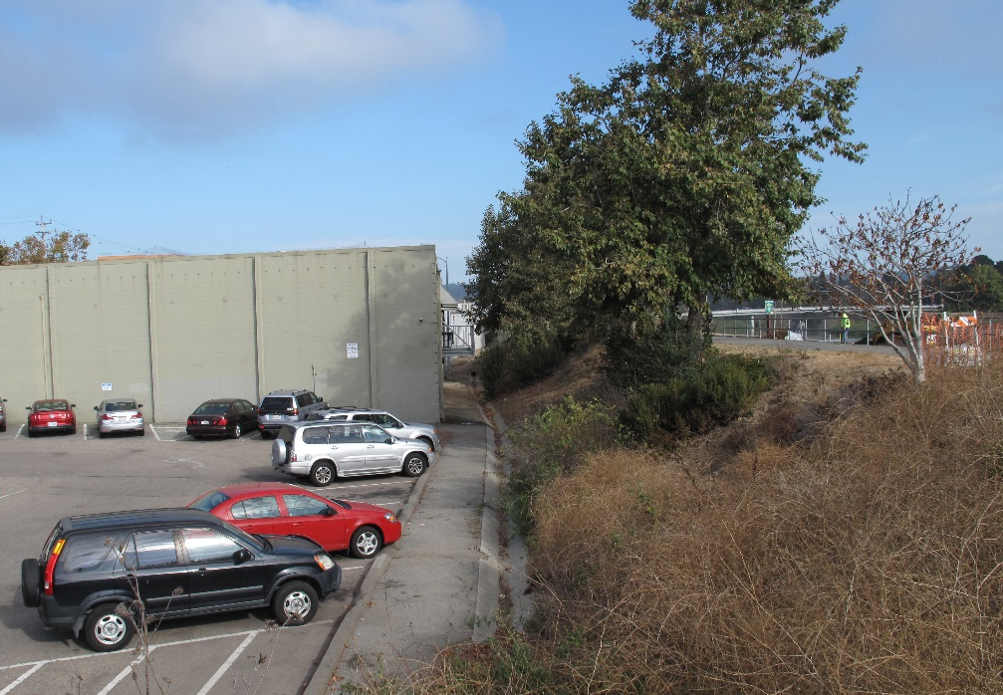
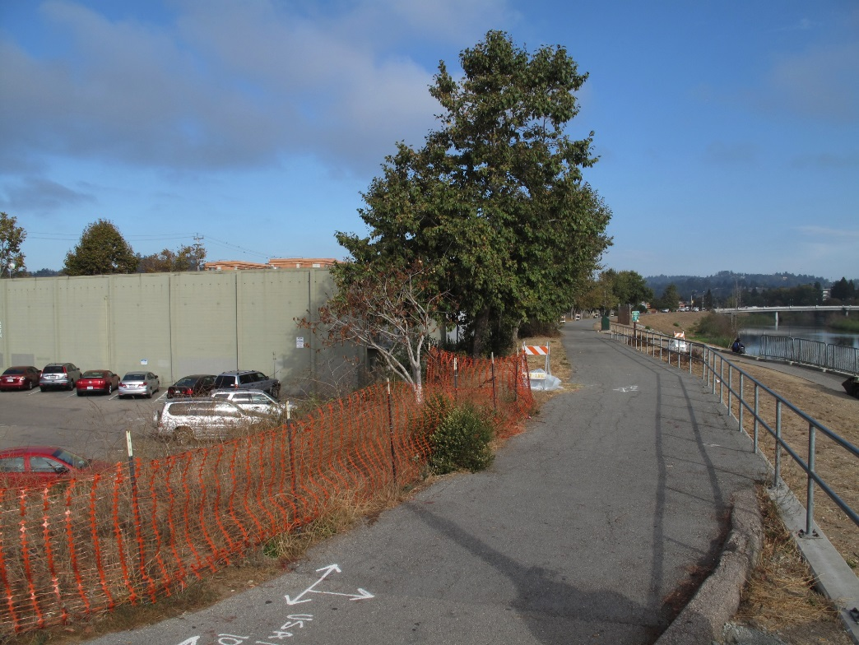
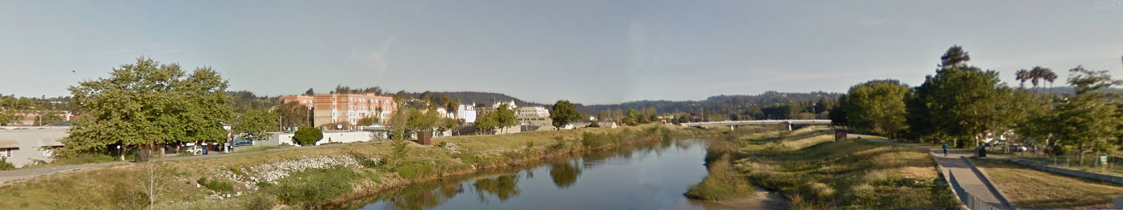
Development Should Have a Positive Relationship with the Riverfront
Notes:
In revising the standards, however, it is important that we recognize the unique conditions that exist in this area – notably the large assembled sites and the area’s relationship with the river.
Today many of the properties back on to the river, creating an inhospitable environment for promenaders on the Riverwalk, and for people trying to get to the river from Front Street.
A key goal of the original DRP and of the San Lorenzo Riverfront Plan was to promote new development that could enhance access to and along the river.
And to promote uses that would foster a positive environment. In this regard, upper-level residential is a use that is given high priority…one that can promote a day and nighttime environment and a strong sense of stewardship.

Slide 20
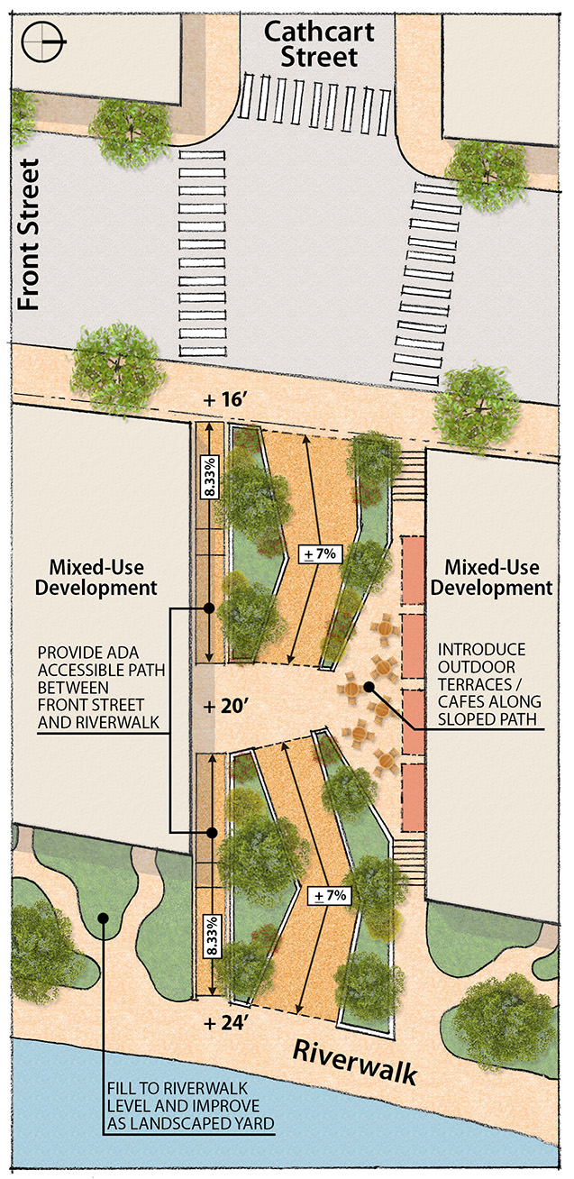
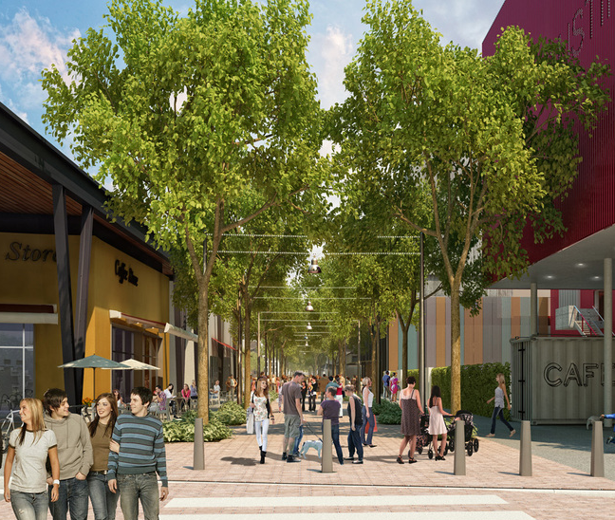
Create High Quality Public Access between Front Street and the River
Publicly Accessible Path
ADA Compliant
Active Pedestrian-Oriented Uses
Public Space Open to the Sky
SANTA CRUZ DOWNTOWN PLAN UPDATE
December 3, 2015
Front Street Riverfront Corridor Development Standards
Proposed Height, Massing and Stepback Standards

Slide 21
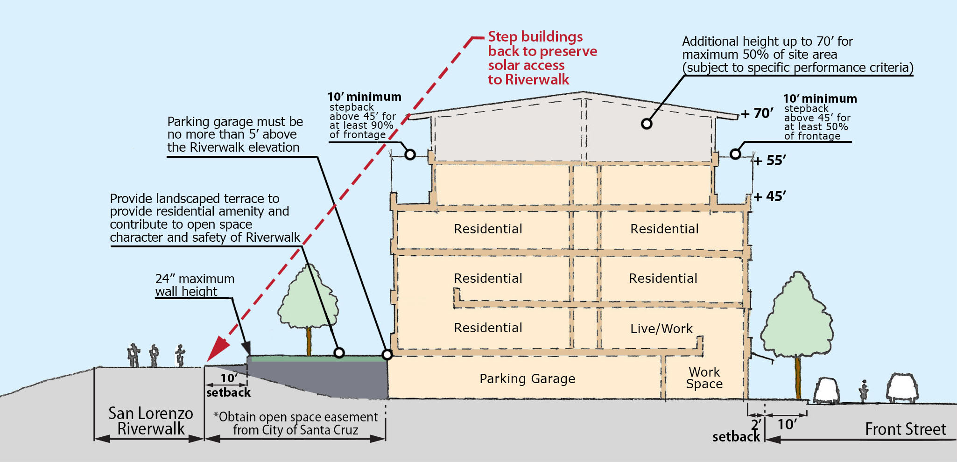
Front Street / Riverfront Development Standards
Iinsert diagram here.
Require at least 50% of the building frontages along Front or Laurel Street and Soquel Avenue to stepback by 10 feet above a height of 45 feet.
Step buildings back by 10 feet along the Riverfront to maintain solar access.
Require new development to fill the space between the levee and Riverwalk.
Live-work as a permitted ground level use along Front Street.
SANTA CRUZ DOWNTOWN PLAN UPDATE
December 3, 2015
Front Street Riverfront Corridor Development Standards
Proposed Height, Massing and Stepback Standards

Slide 22
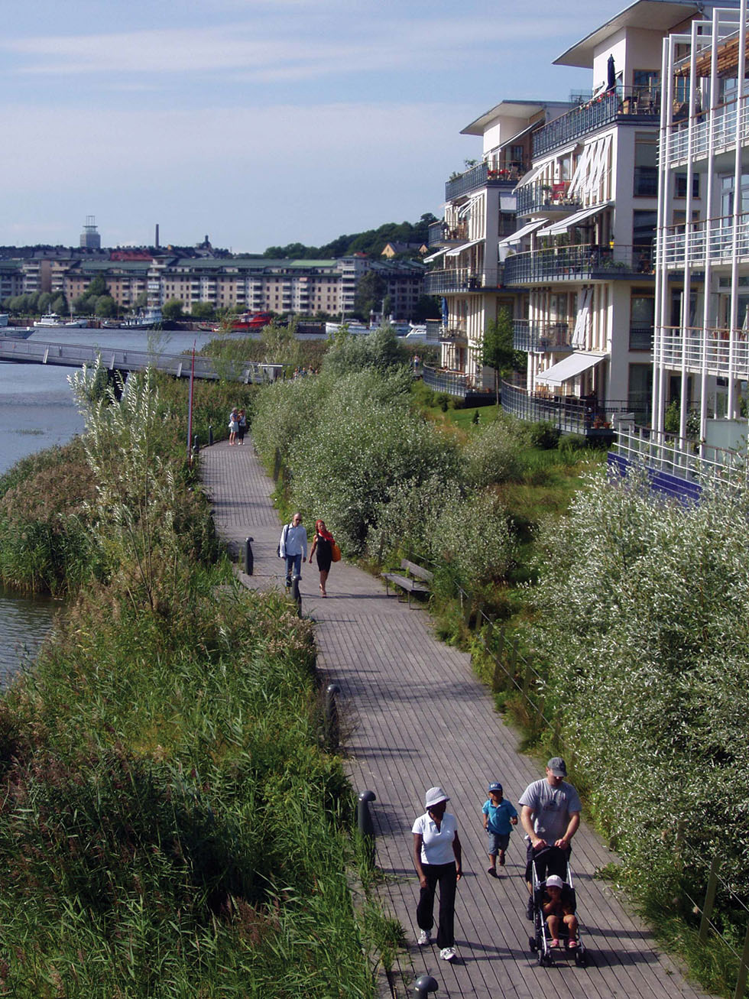
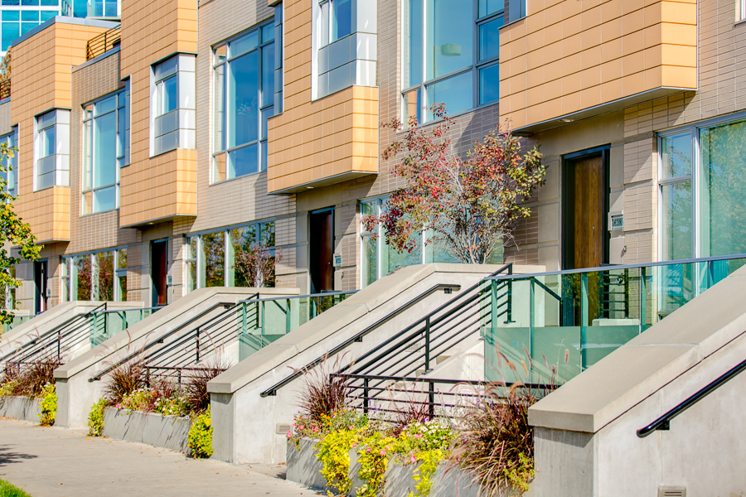
Residential Development can Enhance the Riverfront Experience
It can also Promote Safety and a Stronger Sense of Stewardship
Notes:
In revising the standards, however, it is important that we recognize the unique conditions that exist in this area – notably the large assembled sites and the area’s relationship with the river.
Today many of the properties back on to the river, creating an inhospitable environment for promenaders on the Riverwalk, and for people trying to get to the river from Front Street.
A key goal of the original DRP and of the San Lorenzo Riverfront Plan was to promote new development that could enhance access to and along the river.
And to promote uses that would foster a positive environment. In this regard, upper-level residential is a use that is given high priority…one that can promote a day and nighttime environment and a strong sense of stewardship.

Slide 23
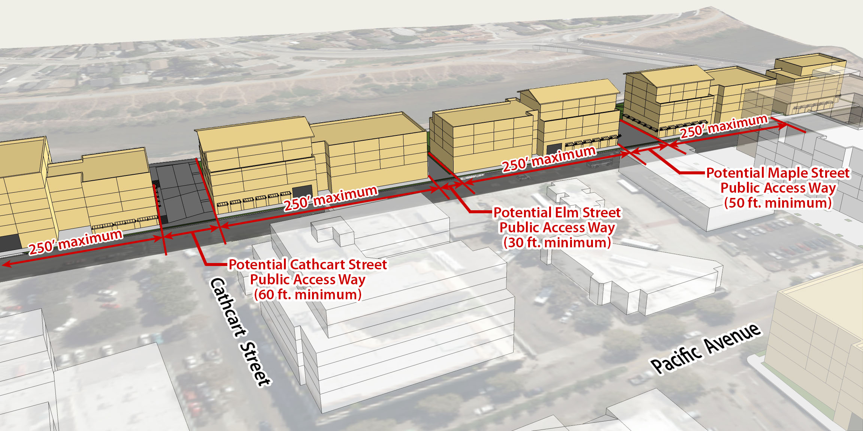
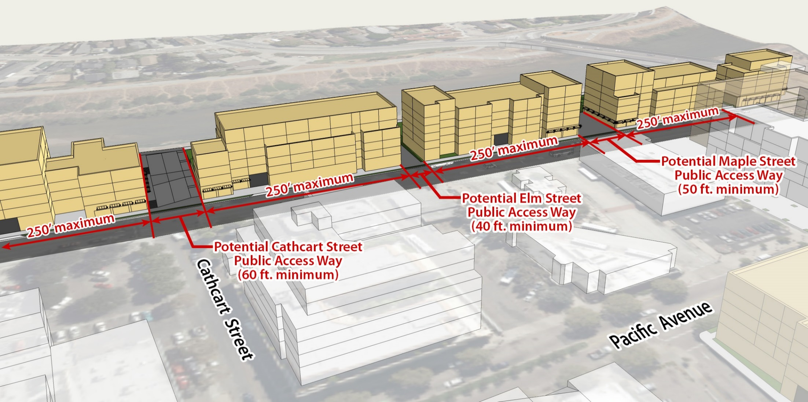
Front Street / Riverfront Development Standards
Iinsert diagram here.
Limit buildings to 250’ in length to provide multiple linkages to the River
Establish 60’ wide linkage near foot of Cathcart Street, 50’ wide linkage near the terminus of Maple Street and a 40’ linkage near the extension of Elm Street.
SANTA CRUZ DOWNTOWN PLAN UPDATE
December 3, 2015
Front Street Riverfront Corridor Development Standards
Proposed Height, Massing and Stepback Standards

Slide 24
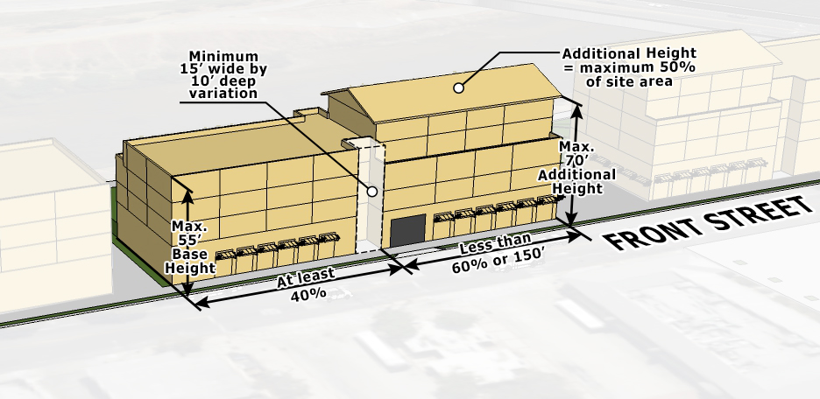
Front Street / Riverfront Development Standards
I
Limit the additional height along each of the street frontages.
Establish a separation to provide a visual break between building volumes.
SANTA CRUZ DOWNTOWN PLAN UPDATE
December 3, 2015
Front Street Riverfront Corridor Development Standards
Proposed Height, Massing and Stepback Standards

Slide 25
Allow Additional Height for Eligible Sites
Criteria for All Sites
Project helps to achieve first principles of DRP (form, scale, housing, accessibility, etc.)
Project creates active and attractive pedestrian-oriented streetscape environment
Development contributes its fair share to implementation of east-west linkages to river
Development helps to achieve other community objectives (e.g., affordable housing)
Pacific Avenue
(In addition to existing DRP criteria)
Development contributes to an improved social and economic environment with a concentration of housing
Project maintains town scale and character of Downtown
Riverfront
(Performance Criteria for Additional Height)
Development helps to connect the significant natural resource of the river with Downtown
Provides high quality public pedestrian/bicycle access between Front Street and the river at Cathcart, Elm and Maple.
Creates positive frontage along the Riverwalk that enhances the pedestrian experience
Existing Height Map
Proposed Height Map Amendment
SANTA CRUZ DOWNTOWN PLAN UPDATE
December 3, 2015
Pacific Avenue Retail District Development Standards
Proposed Additional Height Standards

Slide 26
DOWNTOWN PLAN UPDATE
RECOMMENDED DEVELOPMENT
STANDARD AMENDMENTS
Presentation to the Planning Commission
Prepared by: ROMA Design Group and McCann Adams Studio
December 3, 2015

Slide 27
DOWNTOWN PLAN UPDATE
RECOMMENDED DEVELOPMENT
STANDARD AMENDMENTS
Presentation to the Planning Commission
Prepared by: ROMA Design Group and McCann Adams Studio
December 3, 2015

