Slide 1

AB 481
Military Equipment Funding, Acquisition and Use
Santa Cruz Police Department
Public Safety Committee – March 23, 2022

Slide 2











Objective
Public Safety Committee 3/23/2022
Purpose of AB 481
Citizen Complaint Process
Timeline
Reporting Requirements
Define military equipment
Community Engagement
SCPD’s Policy 705
Impact
Current Inventory

Slide 3
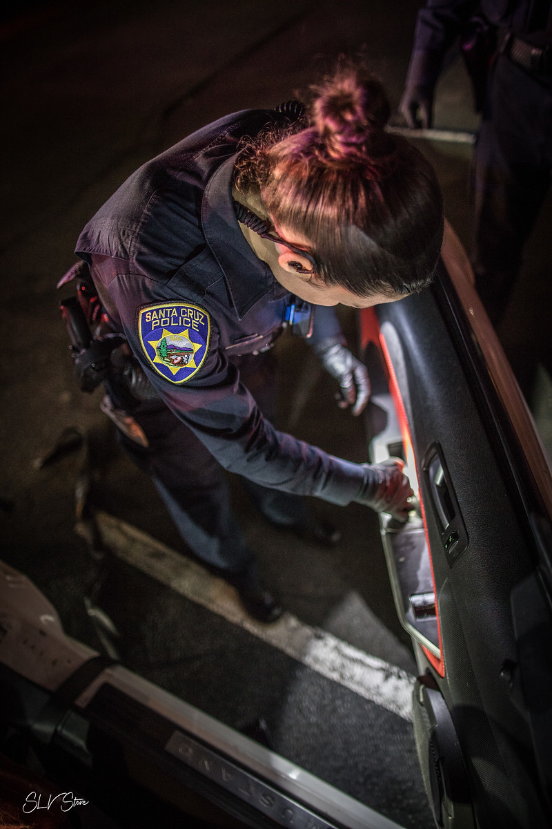
Signed in September, 2021
Effective January 1, 2022
Establishes requirements for acquisition and use of military equipment
What is AB 481?
  Obtain approval of governing body
  Establish policy and post on website
  Public hearing concerning military equipment
  Submit annual report regarding use of equipment
Must be commenced by May 1, 2022
Cease use of items not approved

Slide 4
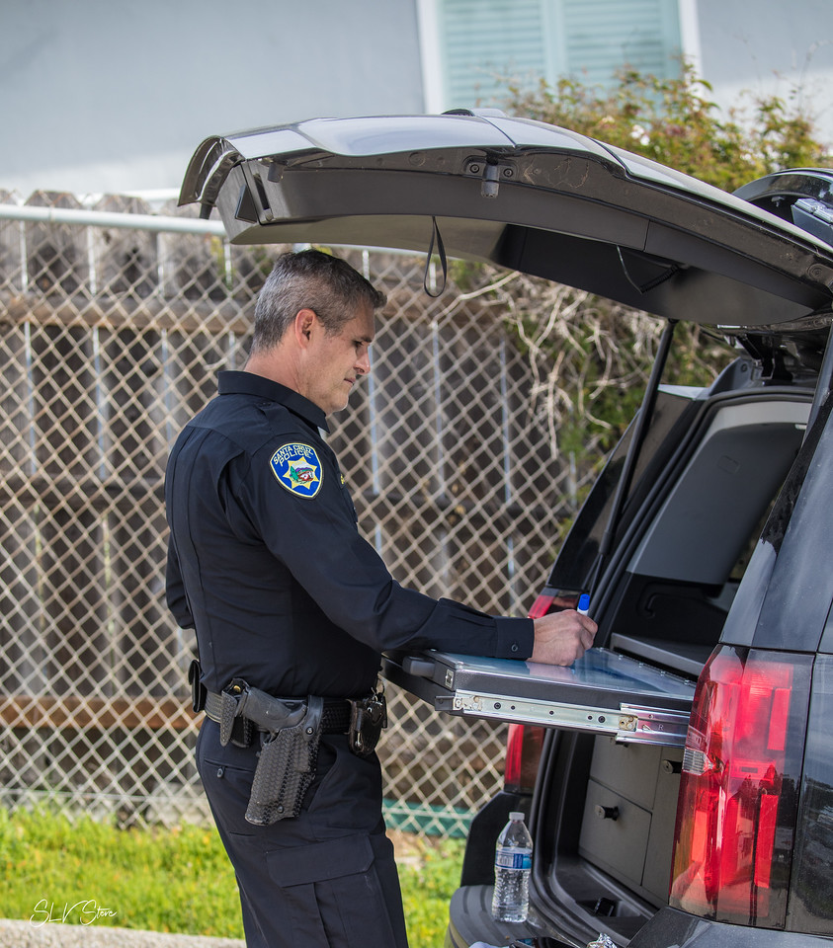
Current Equipment
Why do we have them?
  Historical Use
How do we fund?
  Federal Grants
  City of Santa Cruz General Fund
Law Enforcement Support Program
(1033 Program)
  No equipment obtained from program
  Will not participate in program
AB 481 does not distinguish funding source

Slide 5
AB 481 Categories:
  Drones, robots
  Armored vehicles
  Command and control vehicles
  Firearms of .50 caliber or greater
  Ammo of .50 caliber or greater
  Firearm or accessories designed to launch projectiles
  Flashbangs, tear gas, pepper balls, grenades, etc.
  Projectile launch platforms such as 40mm launchers, bean bags, rubber bullets, etc.
  Any other equipment determined by governing body
Military equipment

Slide 6
SCPD Office Policy - 705
Definition of military equipment
A military equipment coordinator and their responsibilities
Our current military equipment inventory (attached):
Draft Includes…
Description | Authorized Use
Quantity | Expected Lifespan
Capabilities | Fiscal Impact
Purchase Cost | Training
Purpose | Legal and Procedural Rules
Approval requirements
Complaint process
Coordination with other jurisdictions
Annual report
Community engagement

Slide 7
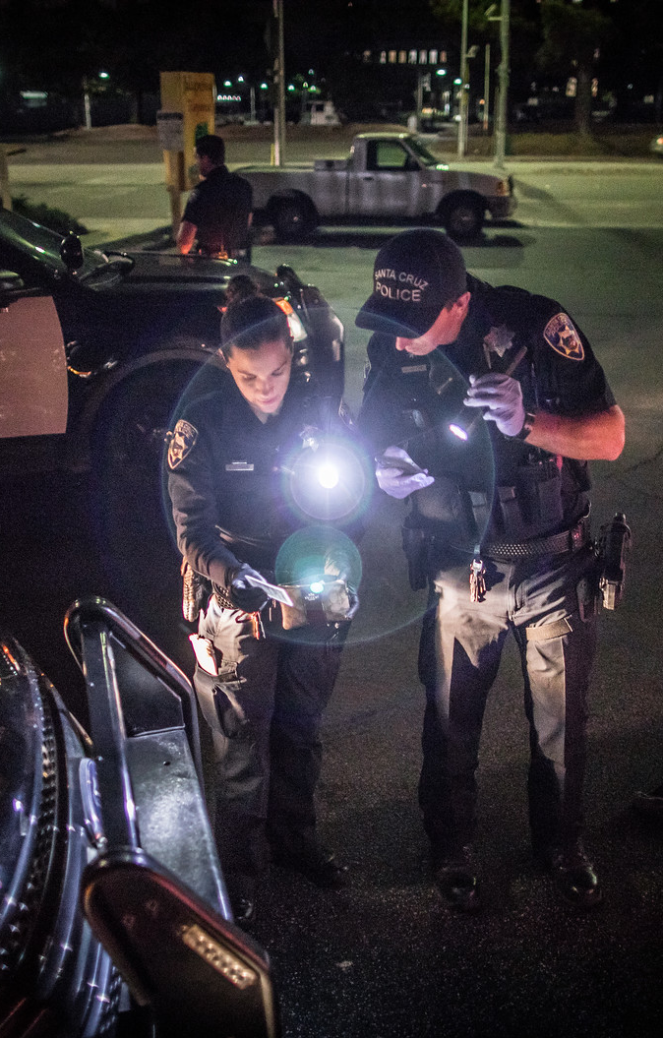
Robots & UAS (Category 1)
Recon Robotics “Throw bot”
  Quantity: 1
  Purpose: Used in high-risk situations where its use may enhance officer or citizen safety
AVITAR II by Robotex
  The Santa Cruz Police Department has access to two throw phone robots maintained by the Santa Cruz County Sheriff’s Office.

Slide 8
Unmanned Aerial Vehicles (Category 1)
  The Santa Cruz Police Department has access to several Unmanned Aerial Vehicles maintained by the Santa Cruz County Sheriff’s Office.
  The Unmanned Aerial Vehicles may be deployed in situations that include, but are not limited to, a search for a missing person, natural disaster management, tactical or other public safety and life preservation situations.

Slide 9
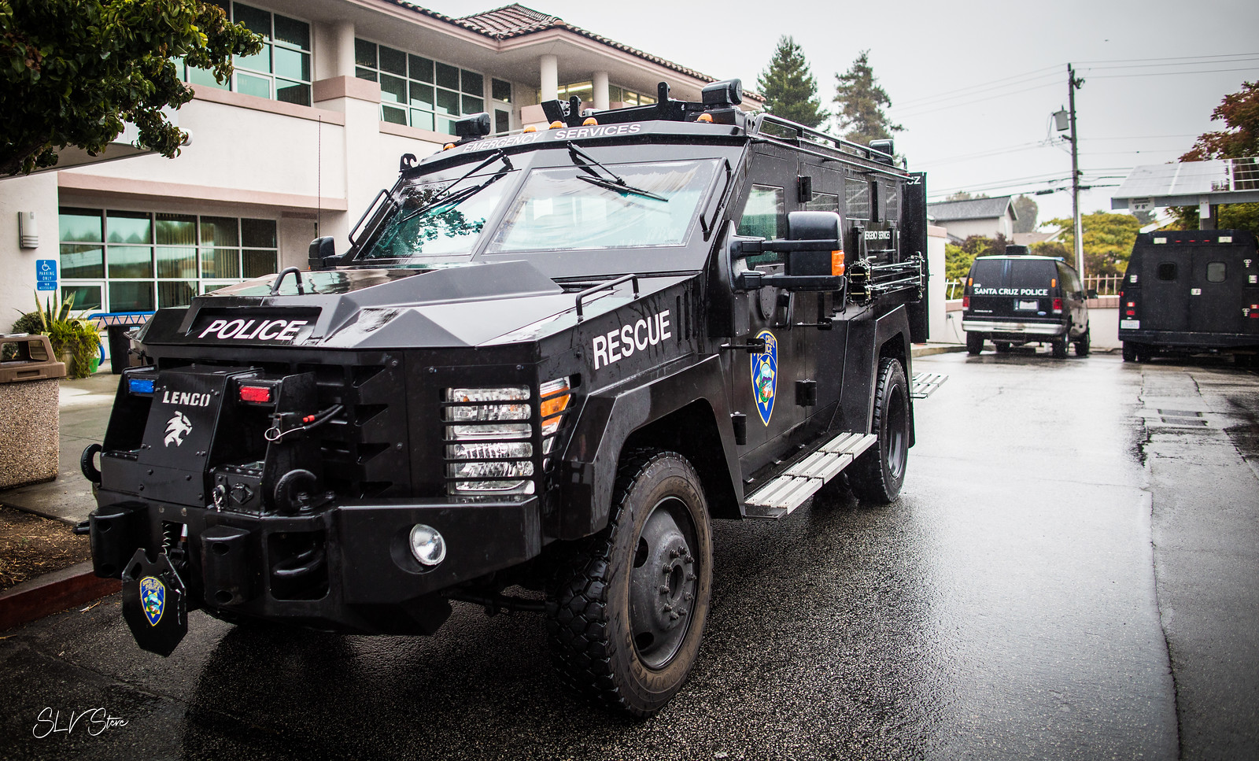
Armored Personnel Carrier
(Category 2 & 3)
Lenco Armored Rescue Vehicle Purpose:
  To be used in response to high-risk or critical incidents to enhance officer and community safety, assist in scene containment and to assist in resolving critical incidents.

Slide 10
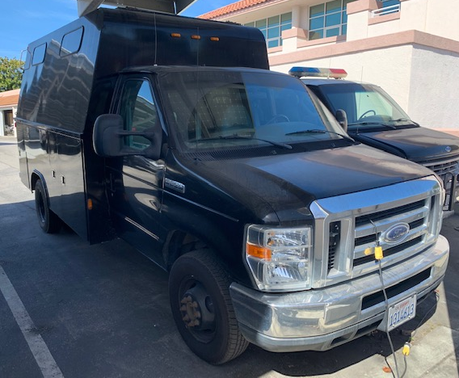
Ford F350 Transport Vehicle (ESU Truck, Category 5)
2008 Ford F350 transport vehicle
Description:
    A standard Ford F350 truck chassis with a large box type compartment attached to the chassis from the cab back. The interior of the compartment is fitted with shelving and seats. The outsides of the compartment are fitted with multiple storage boxes.
    The vehicle contains various equipment, spare ballistic shields, breeching tools, small tools, medical supplies, pens, writing tablets, power inverters etc.

Slide 11
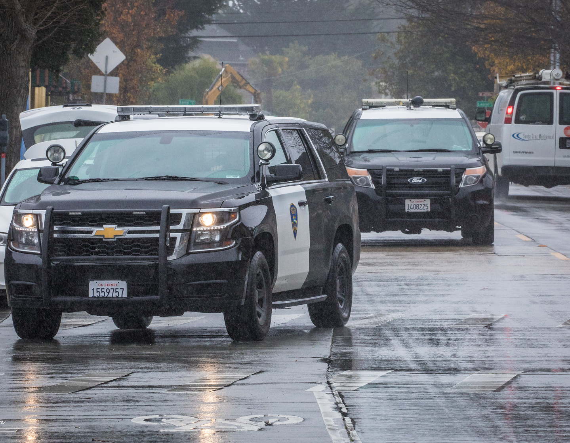
Command and Control Vehicles
(Category 5)
Chevy Tahoe Patrol Vehicles:
(1) 2018 Model (Lieutenant)
(3) 2019 Models (Sergeants)
These vehicles can act as a Mobile Command Center. The vehicle is equipped with file cabinets, dry erase board, medical supplies and additional mapping equipment.

Slide 12
Firearms of Greater than .50 Caliber (Category 8)
Mossberg 590 -12 Gauge Pump Action Shotguns
Quantity: 2
Purpose:
These shotguns are specifically designed to be used as breaching tools. They are intended to be used in a situation where rapid entry into a structure is required, (i.e. hostage situation).
They are used to defeat the locking mechanism of a door or the hinges of door by firing a breaching shotgun round into these areas.
Remington 870 -12 Gauge Pump Action Chemical Agent Launching Shotgun
Quantity: 1
Purpose:
This shotgun was repurposed from an out of service shotgun that SCPD already had in inventory. This shotgun is specifically designed to launch a specific type of chemical munition.
Though based on a standard 12 gauge shotgun, it is not designed or capable of firing lethal shotgun rounds. The buttstock and fore-end are bright orange and it is marked as a “Less Lethal” weapon.

Slide 13
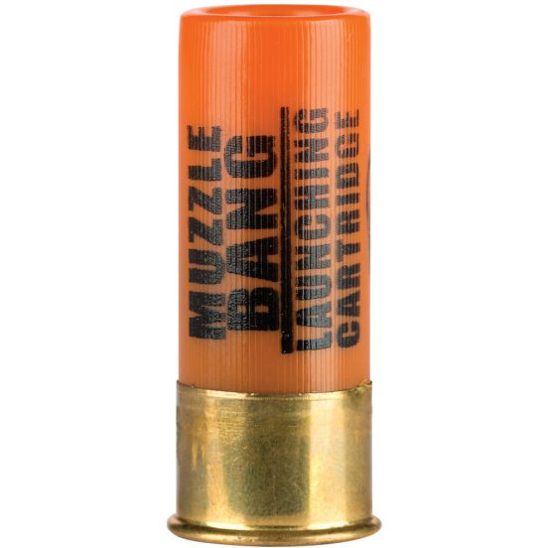
Ammunition of .50 Caliber or Greater
(Category 9)
Twelve-Gauge Launching Cartridges
(Defense Technologies Part Number 1210)
Quantity: 55
These are essentially blank shotgun cartridges. They utilize black powder as the propellant
Purpose:
When used with launching shotgun, the pressure created in the barrel by the expanding gasses of the black powder propellant provide enough force to launch the chemical agent canister from the shotgun.

Slide 14
Specialized Firearms and Ammunition of Less Than .50 Caliber (Category 10)
Defiance bolt action precision rifles
Quantity: 3
Accuracy International AT series bolt action rifle
Quantity: 1
Hornady .308 155 grain ELD Match TAP ammunition
Quantity: 3,200
Within the Emergency Services Unit Tactical team, the department maintains a Precision Rifle team. These officers are trained in the use of precision rifles that are specifically designed to stop lethal threats at various distances and through barrier mediums that a carbine rifle would not.
These specialized firearms provide officers with the ability address lethal threats with more precision, at greater distances than a Carbine rifle or handgun are capable.

Slide 15
Flashbangs, Teargas and Pepperballs (Category 12)
“Stinger Grenades”
Quantity: 10
Rubber ball containing a small NFDD in addition to 60 .32 caliber rubber balls.
When used, the grenade separates along its hemisphere and expels the balls while simultaneously giving a loud bang and bright flash.
These are useful in riot situations, (a means to disperse groups of violent, armed or dangerous individuals) as well as providing a disorienting effect of the NFDD component to disorient and mitigate dangerous behavior.
NFDD (Noise, Flash, Diversionary Device)
8902NR (12) gram low roll NFDD
Quantity: 40
7007 (4) gram NFDD training reloads
Quantity: 26
Commonly referred to as “flashbangs” are a single use device that that emits a loud bang and a very bright flash.
They are designed to disorient and distract dangerous subjects by overwhelming their senses and provide a window of time, approximately 6-8 seconds, allowing officers to take control of dangerous or high-risk situations.

Slide 16
Chemical Agents “Teargas” (Category 12)
1082 Riot Control CS Canister
  Quantity: 12
1032 Tri-Chamber Flameless CS Canister
  Quantity: 14
5230B Baffled Launchable CS Canister
  Quantity: 10
1026 Triple Chaser Separating Canister
  Quantity: 20
56854 Aerosol OC Fogger
  Quantity: 4
2262 40mm CS Liquid Ferret Projectile
  Quantity: 44
2260 40mm OC Liquid Ferret Projectile
  Quantity: 10
The Santa Cruz police department uses chemical agents, commonly referred to as “teargas” as less-lethal tools, to disperse rioting subjects and on barricaded suspects.
The two agents the department uses are CS (2-chlorobenzylidene malononitrile) and OC (Oleoresin Capsicum). CS is an irritating agent and a lachrymator; it irritates the eyes and causes tearing. It also irritates the respiratory system causing coughing. These reactions are temporary and subside rather quickly especially if the subjects remove themselves from the area where the chemical agent has been deployed. These symptoms generally subside within an hour or less of exposure.
OC is legal for civilians to possess in certain quantities.

Slide 17
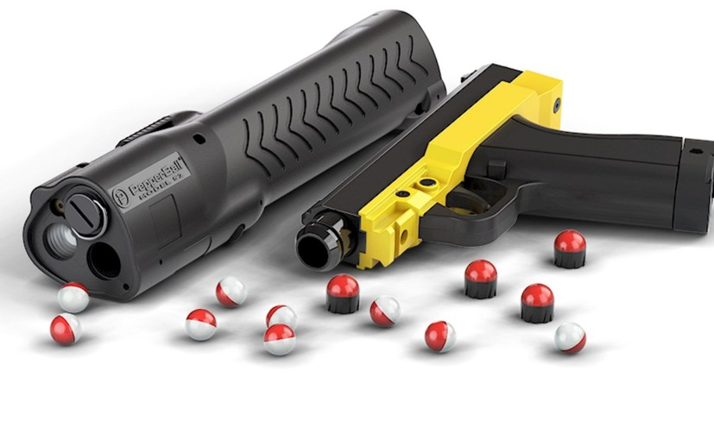
Pepperballs (Category 12)
Pepperball Guns:
Quantity 4
The intention of Pepperballs is to limit escalating such as with self destructive, dangerous or combative individuals, riot or crowd control situations or other violent civil unrest.
Pepper Ball guns are a compressed air powered launcher, almost identical in manufacture to a common paintball gun. It fires .68 caliber plastic balls that contain an irritant powder.
Pepper Balls are a .68 caliber projectile. They are a plastic shell that contains an irritant powder that consists of PAVA, a pepper derivative. This powder causes a burning sensation and involuntary eye closure when coupled with the impact of the projectile.

Slide 18
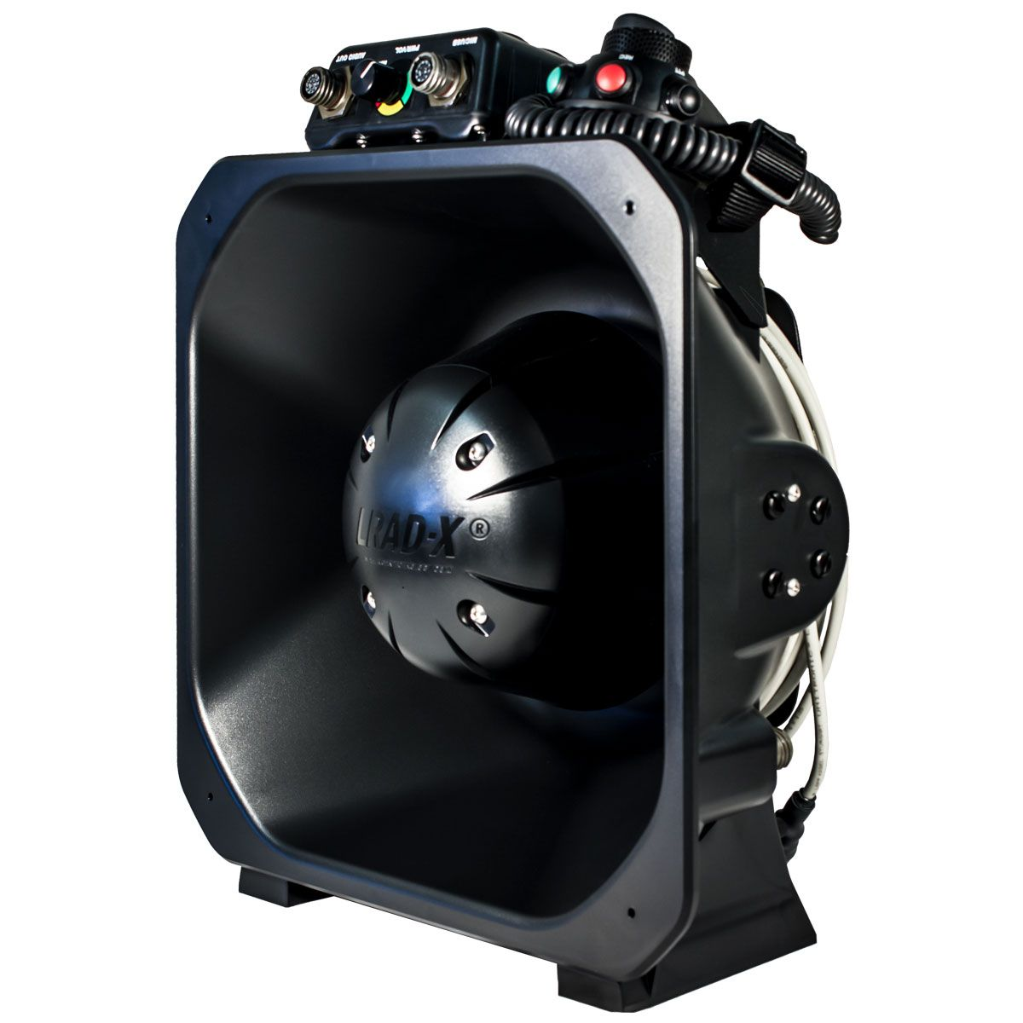
Long Range Acoustic Device (Category 13)
GENASYS Inc. LRAD-100X
This device is a self-contained, lightweight, battery operated hailer that communicates with great intelligibility up to 600 meters. It emits acoustic sound pressure levels up to 140db.
Used as a notification/communication system during critical incidents, where the user is conveying a message to a person or persons.
Used during violent or riotous situations as a means to advise participants that they are involved in legally prohibited activities
Broadcasts alert tones in a directed manner at persons involved in riotous or destructive behavior as a means of dispersing the crowd and stopping the behavior

Slide 19
40mm Projectiles (Category 14)
40mm Projectile Launchers
Defense Technologies DT1325 40mm-single barrel launchers
  Quantity: 14
Lewis Machine and Tool 1425 40mm single barrel launchers
  Quantity: 15
Lewis Machine and Tool 1440 40mm 4 shot multi launchers
  Quantity: 2
Penn Arms PGL65-40 40mm 6 shot multi launcher
  Quantity: 1
Less lethal tool to apply pain compliance to self-destructive, armed or combative/resistive persons, to prevent them from causing harm to themselves or others. Also used during violent riots or large crowd control disturbances. They can be used to address individuals throwing items such as rocks, bottles, Molotov cocktails etc.
40mm Ammunition
Exact Impact 40mm
  Quantity: 140
Direct Impact 40mm OC
  Quantity: 24
Direct Impact 40mm Marking
  Quantity: 32
Training Sponge ammunition 24 round kit
  Quantity: 7
The projectile is made of a foam rubber often called a “sponge round” as the projectile has a consistency similar to a sponge. It is designed to incapacitate people through pain compliance and impact.

Slide 20

Commendation, Inquiries, or Complaints
Any member of the public wishing to submit a complaint, concern, or question regarding the Department’s use of each specific type of military equipment, should contact the Department’s Professional Standards Unit.
Comments can be submitted through the SCPD website:
  www.cityofsantacruz.com/government/citydepartments/police/community/police-department-feedback
The Department will work diligently to timely respond to the public submittal of complaints, concerns, and/or questions regarding the Department’s use of each specific type of military equipment.

Slide 21
Report Includes:
Use of equipment
Complaints received
Internal audits
Other information violations of policy
The cost of such use
Any other similar information
First Annual Report due May, 2023
Annual Reporting Requirements

Slide 22
Community Engagement
March 18, 2022
April 7, 2022
April 26, 2022
Posted draft of SCPD Policy 705
Chief’s Advisory Body Meeting
City Council Meeting
www.SantaCruzPolice.com
Present draft policy and receive feedback.
Present to City Council for first reading.
March 23, 2022
April 11, 2022
May 10, 2022
Virtual Community Meeting
City Council Meeting
Public Safety Committee
Present to City Council for second reading (if needed)
Present draft policy for PSC and public feedback.
Present to the public with Q&A.

Slide 23


Impact
Without Approval:
Change in response to critical incidents
Change in response to mutual aid
Decreased safety to law enforcement, public and involved subjects
Lapse in training and skill sets
Affects retention and recruiting
Challenge of equipment disposal/storage
With Approval:
Continued use of equipment
Increased safety to community, law enforcement, and involved subjects
Increased transparency

Slide 24

Questions?

